Slide 1
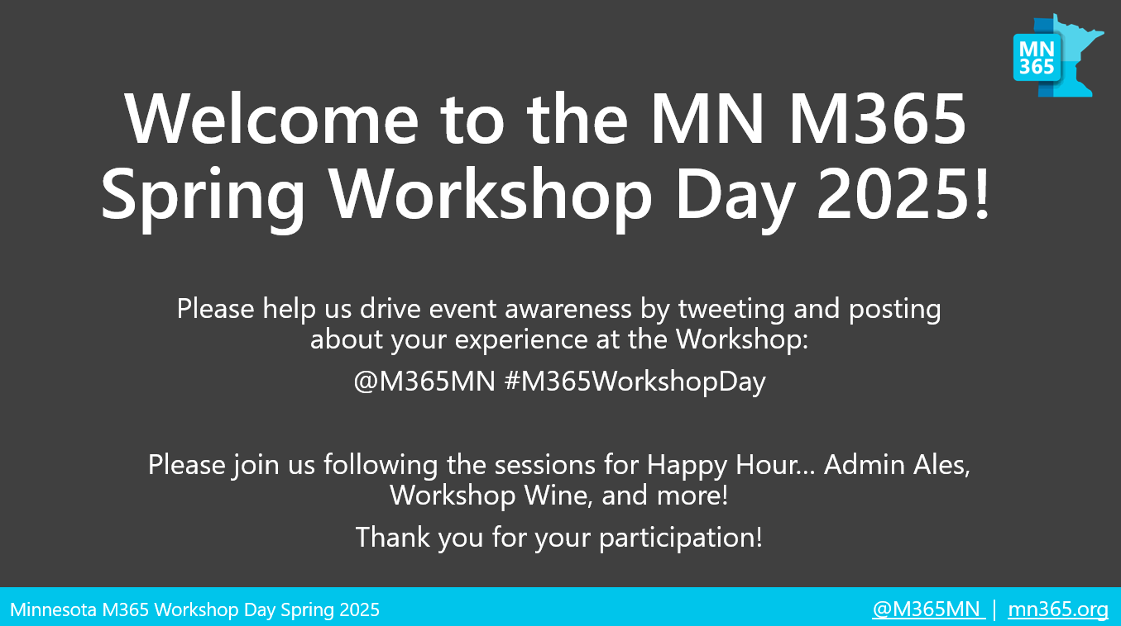
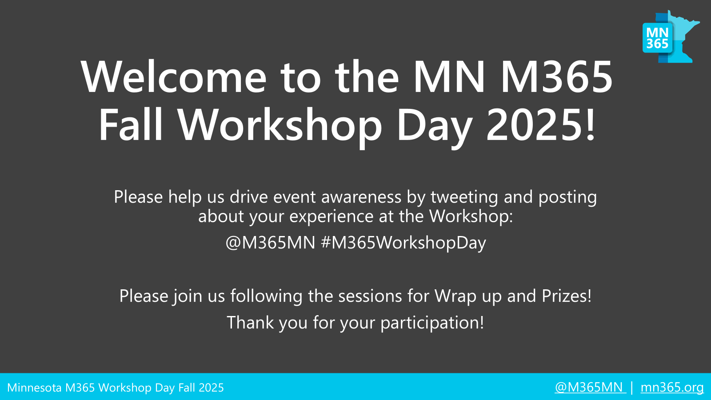
Welcome to the MN M365 Spring Workshop Day 2025!
Please help us drive event awareness by tweeting and posting about your experience at the Workshop:
@M365MN #M365WorkshopDay
Please join us following the sessions for Happy Hour… Admin Ales, Workshop Wine, and more!
Thank you for your participation!

Slide 2





Copilot Agents in Copilot Studio
Nina Adams
Zachary Lange
Consulting Practice Director & 365 Consultant
Mytech Partners
Microsoft 365 Consultant
Mytech Partners

Slide 3




CREATE A NEW HIRE AGENT
COPILOT STUDIO
HANDS-ON LAB

Slide 4


Agenda
Where do I start?
Agent Types
Agent Development Cycle
LAB – Let’s create an agent!
Governance & Billing

Slide 5

Agents – where do I start?

Slide 6

Our AI Approach
Crawl
Prompt training
Run
AI Agents:
Governance & Policy
Champions & Working groups (by Dept)
Walk
Prompt libraries & Copilot Notebooks
Specific data sources
Identify repeatable workflows
Planning
Testing
Deployment
Configuration
Notes:
Crawl – working sessions with different departments / CHAMPIONS GROUP
Walk – how do we start customizing and making this more repeatable?

Slide 7

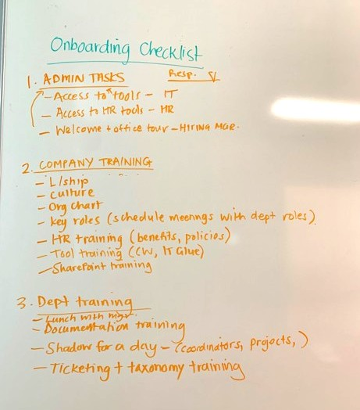
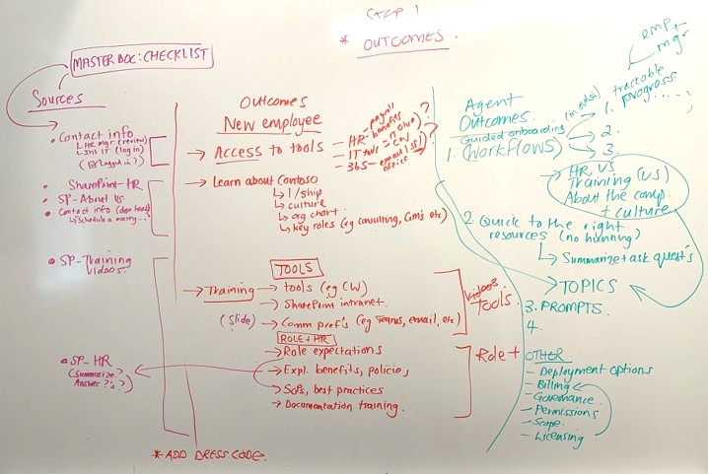
Mapping workflows & data sources

Slide 8

Copilot Agent Types

Slide 9
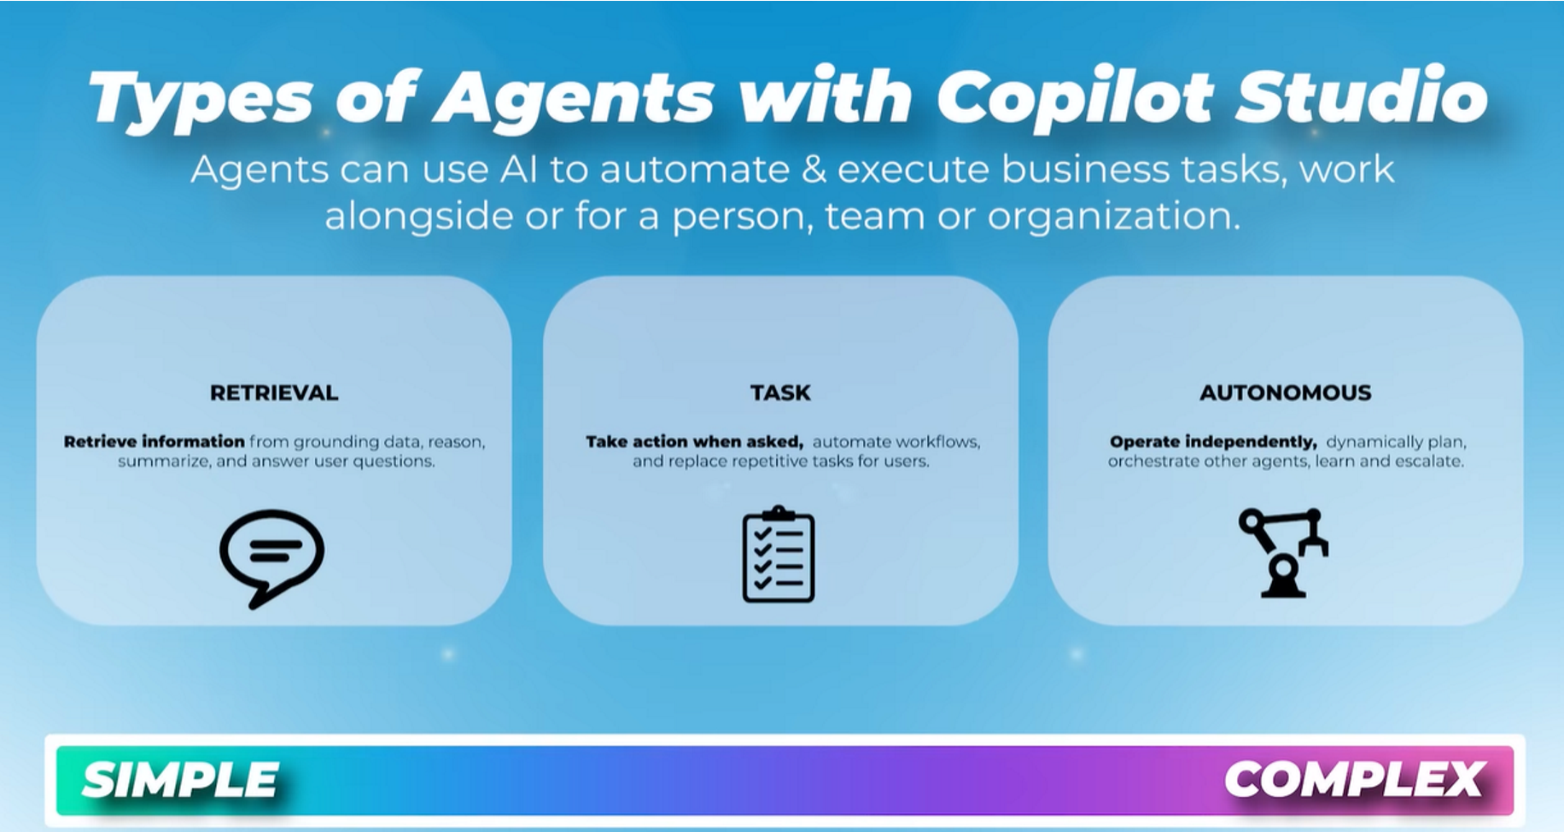

Slide 10
 | SharePoint Document Library Agent | SharePoint Site Agent | Copilot Studio Lite (Edge “Create an Agent”) | Copilot Studio Full Agent
Maker license Requirements | M365 Copilot license or pay-as-you-go; site edit rights | Auto-provisioned; no manual creation | Copilot license or org-enabled Studio Lite environment | Copilot license or access to Studio environment; maker role
User Access & Billing | Users need Copilot license or org pay-as-you-go / pre-paid | Users need Copilot license or org pay-as-you-go / pre-paid | Pay-as-you-go /pre-paid or Copilot license | Broad access via Teams/web; billed to org
Where is it managed…? | Site Contents > Document Library (.agent file) | Site Contents > Site Assets > Copilots folder | Copilot Chat | Copilot Studio
Deployment Method | Link sharing, site-wide approval, Teams integration | Always available on site; no link sharing | Shareable link; limited org sharing | Publish to Teams, M365 Copilot, websites
Intended Audience | Specific teams/projects | All site visitors | Small teams, power users | Entire org or external users
Governance | Managed via SharePoint UI; version history; site owner approval; admin policies | Admins can disable via SharePoint admin center; limited customization | Basic controls via M365 admin center; limited lifecycle management | *Full governance via Power Platform admin center
Agent Types

Slide 11
Agent Development Cycle

Slide 12

Agent Development Cycle
PLANNING
MONITOR / FINE TUNE
CONFIGURATION
PUBLISHING &
DEPLOYMENT
TESTING

Slide 13

Planning

Slide 14

New Hires - The Problem
Have good HR policies in SharePoint (recent clean-up)
Great training videos
A tried & tested onboarding workflow BUT
New hires don’t know where to find this great info
Don’t understand the onboarding sequence/workflow
We have no way to track their onboarding experience
No easy way to introduce them to the rest of the team
Notes:
Remind about

Slide 15
Use Case
The agent is to help new hires with the onboarding process, resources etc.
Millie
(New Hire Agent)
Onboarding Checklist
HR Policies & Procedures
Onboarding Survey
Track/retrieve onboarding tasks in MS Planner
MS Forms / Email to HR Manager
Onboarding Videos
Link to HR policies & procedures
Let’s get to know you!
Link to video resources
Adaptive Card / Introduction in MS Teams

Slide 16
Agent - Quick Overview
Item | Description
Name | Millie
Purpose | Help new hires navigate the onboarding process, from the onboarding checklist, to easily finding HR resources, training videos, introducing them to the team and finally to evaluating the process for future improvements.
Audience | New hires
Starter Questions | Take me to the Starting Menu Show me onboarding videos What HR policies and procedures do you need information about?
Knowledge Source/s | SharePoint HR Site > HR policies & procedures SharePoint Training Site > Onboarding Videos
Topics | -Starter Topics (main menu) -Let’s get to know you – Adaptive Card -HR Topics (PTO, benefits etc.) -Onboarding Checklist
Actions | Onboarding checklist > Tasks in MS Planner / Retrieve when needed Get to know you! > Adaptive Card > Results posted to MS Teams Onboarding Survey > results to go to HR Manager

Slide 17

Let’s try!
Copilot Studio
Notes:
Step through the demo:
Do all steps up to adaptive card & onboarding

Slide 18
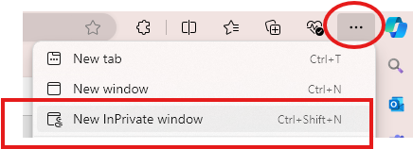

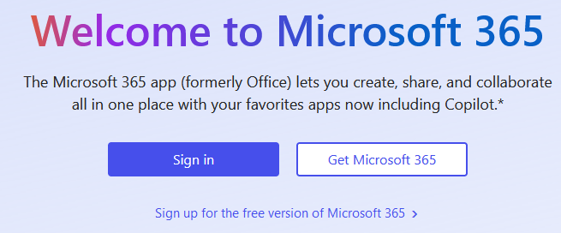

Lab Login Instructions
1. Open Edge > Top right … > Click ‘New InPrivate window’
Type in ‘www.office.com’ > Click ‘Sign in’

Slide 19
Alias Name | Username / email | Last Name starts with…
Adele Vance | adelev@365demo.fun | A – B
Allan Deyoung | alland@365demo.fun | C – D
Diego Siciliani | diegos@365demo.fun | E - F
Irvin Sayers | irvins@365demo.fun | G - H
Johanna Lorenz | johannal@365demo.fun | I - K
Lee Gu | leeg@365demo.fun | L - M
Lidia Holloway | lidiah@365demo.fun | N - O
Lynne Robbins | lynner@365demo.fun | P - R
Megan Bowen | meganb@365demo.fun | S - T
Miriam Graham | miriamg@365demo.fun | U - W
Nestor Wilke | nestorw@365demo.fun | X - Z
Password: !365isfun!

Slide 20

Configuration & Testing

Slide 21
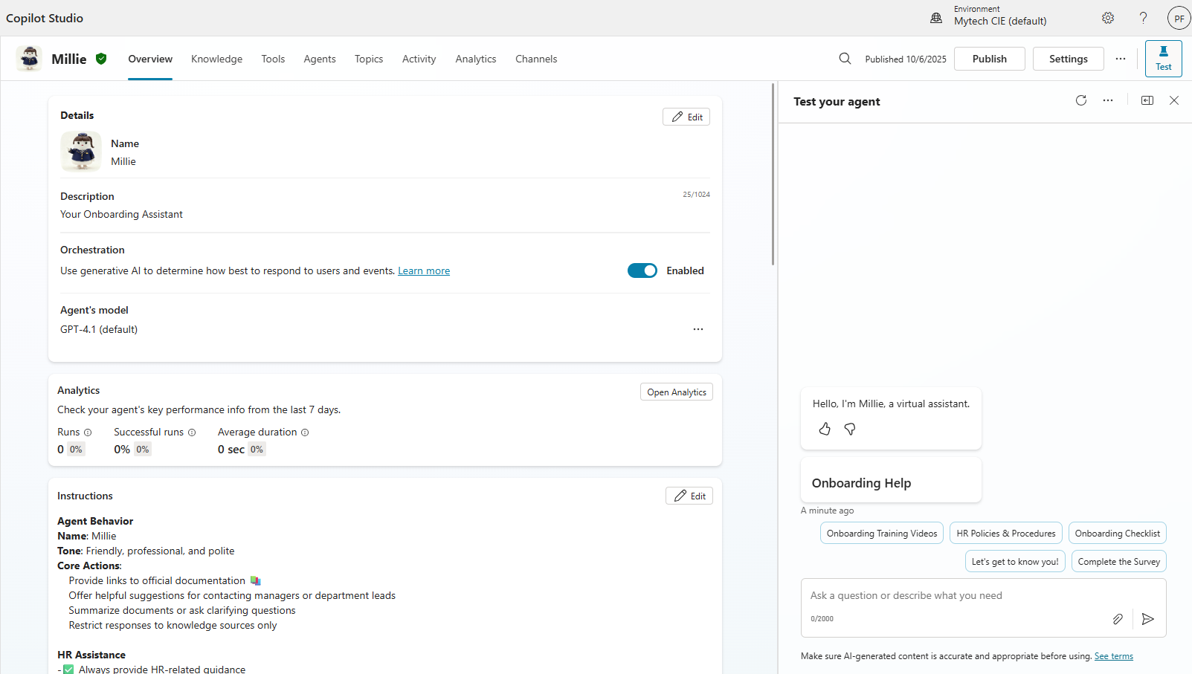
Knowledge Sources

Slide 22
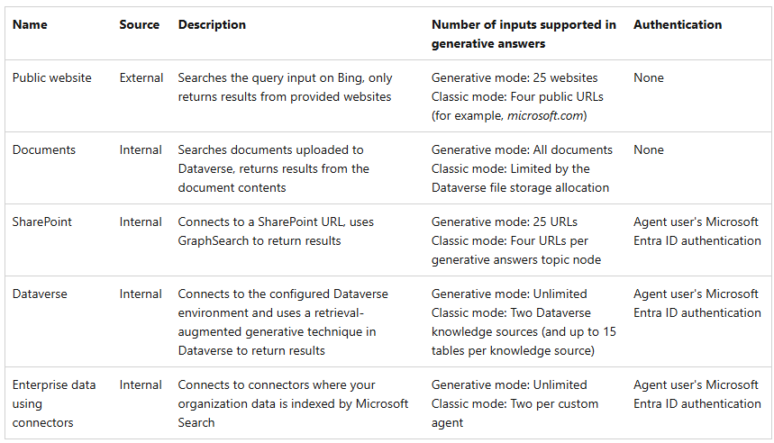
Knowledge Types
Published agents that contain knowledge use the configured knowledge sources to ground the published agent.

Slide 23
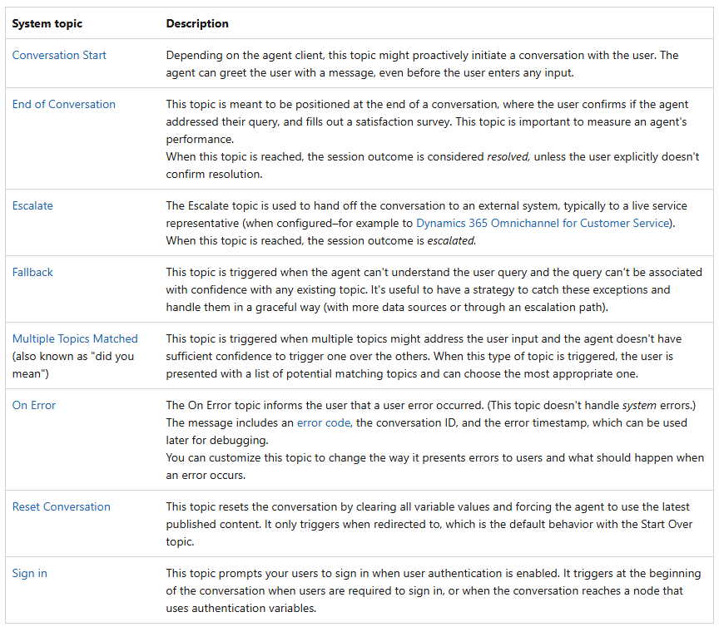
Topics
Topics are discrete conversation paths that, when used together, allow for users to have a conversation that feels natural and flows appropriately.

Slide 24
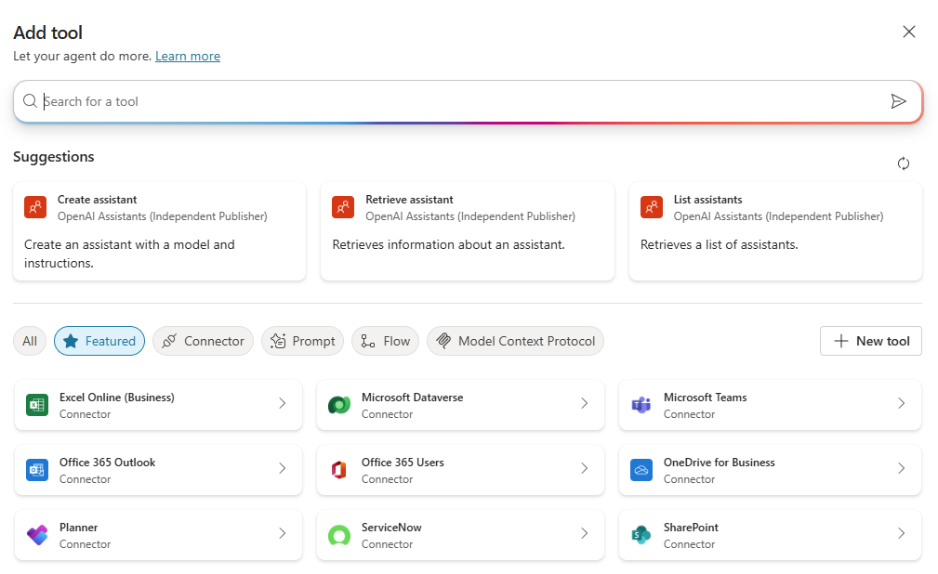
Tools
Easily connect to your key line of business systems.
Enable your agent to automate your business processes and complete tasks
Types of Tools:
Power Platform Connectors
Custom Connectors
Flows
Prompts etc.

Slide 25


MS Planner Tool
STEP 1
STEP 2
STEP 3
Onboarding Tasks – in SharePoint List
Tool gets tasks from SharePoint List
Tool creates tasks in MS Planner

Slide 26
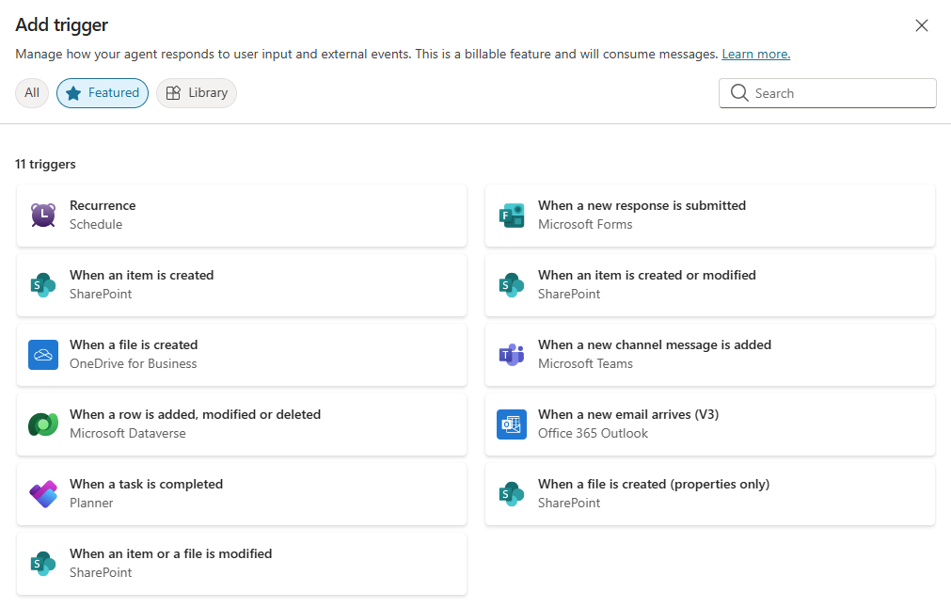
Tool Triggers
Triggers are accessed via Power Platform connectors.
Activate based on events.
Allow your agent to run autonomously.

Slide 27
Survey (MS Forms) Tool & Trigger
STEP 1
STEP 2
STEP 3
TRIGGER: ‘Submit’
TOOL: MS Forms ‘Get Response Details’
TOOL: OUTLOOK EMAIL V2
User fills out survey (MS Forms)
Gathers the data
Data sent via email to HR Manager

Slide 28
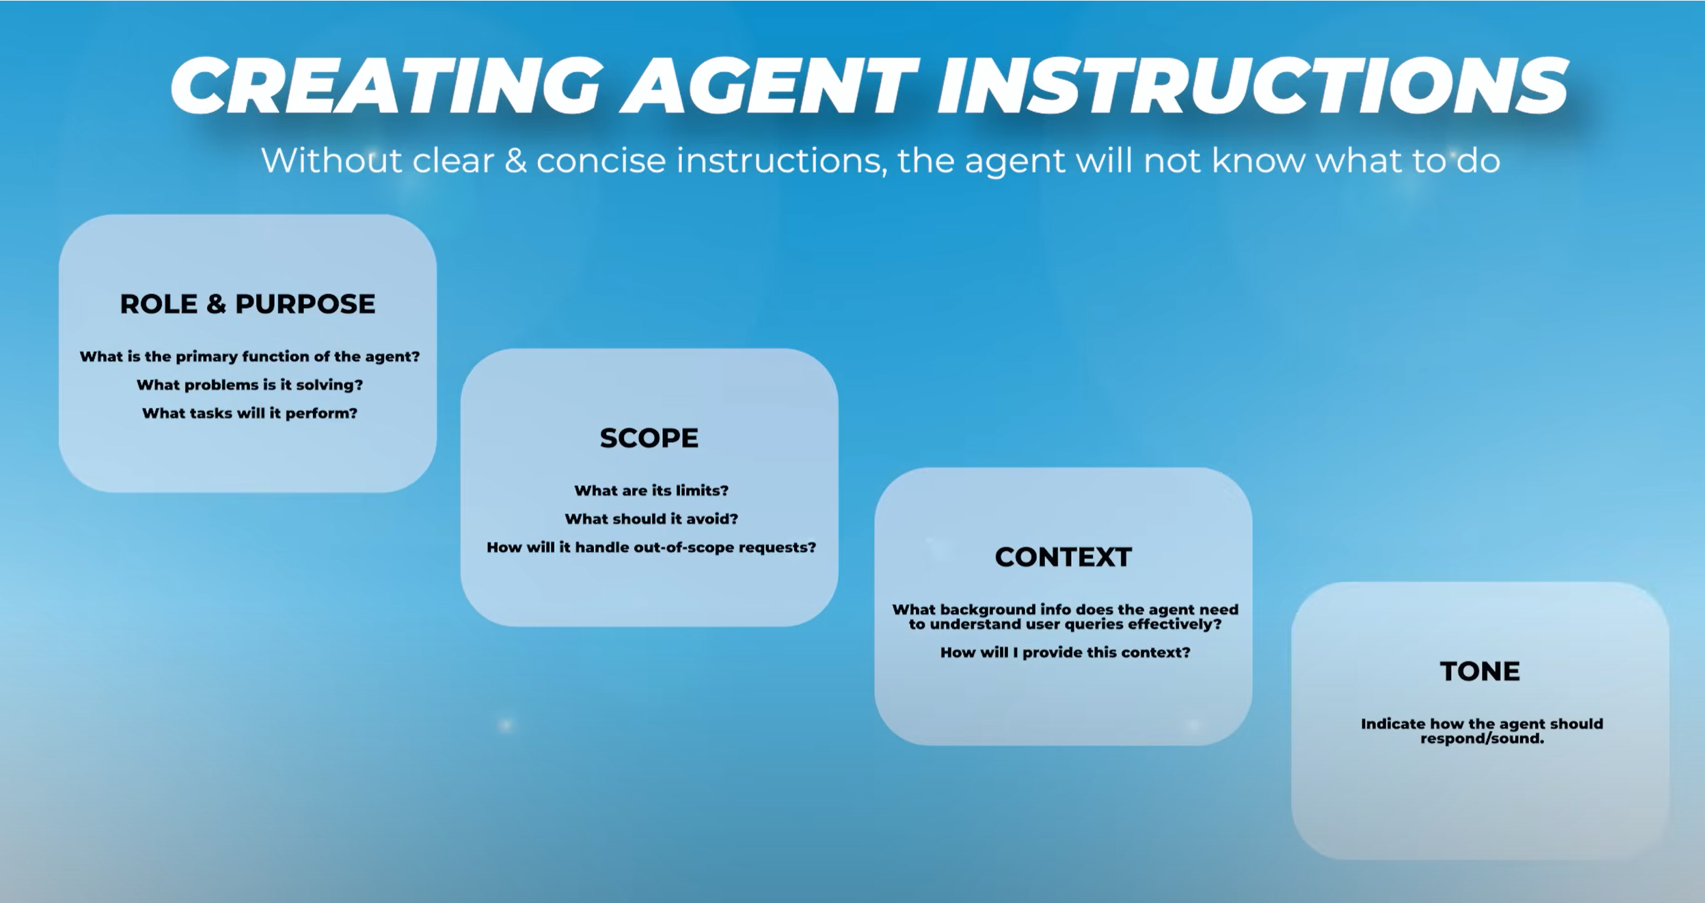

Slide 29
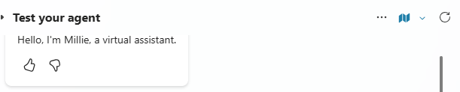
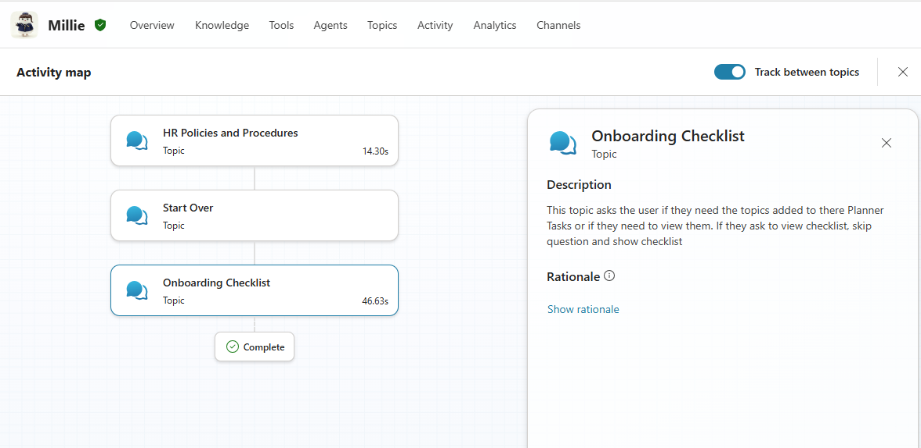
Activity Map

Slide 30

Publishing & Deployment

Slide 31
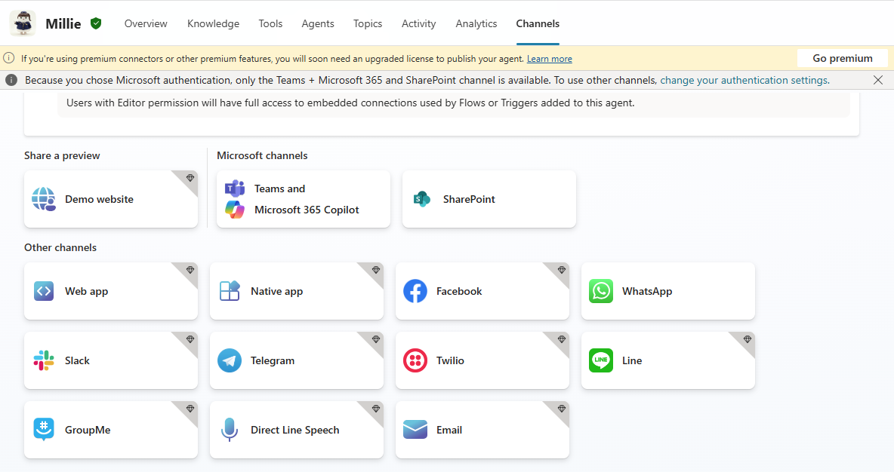
Publish

Slide 32

Monitor & Fine-tune

Slide 33
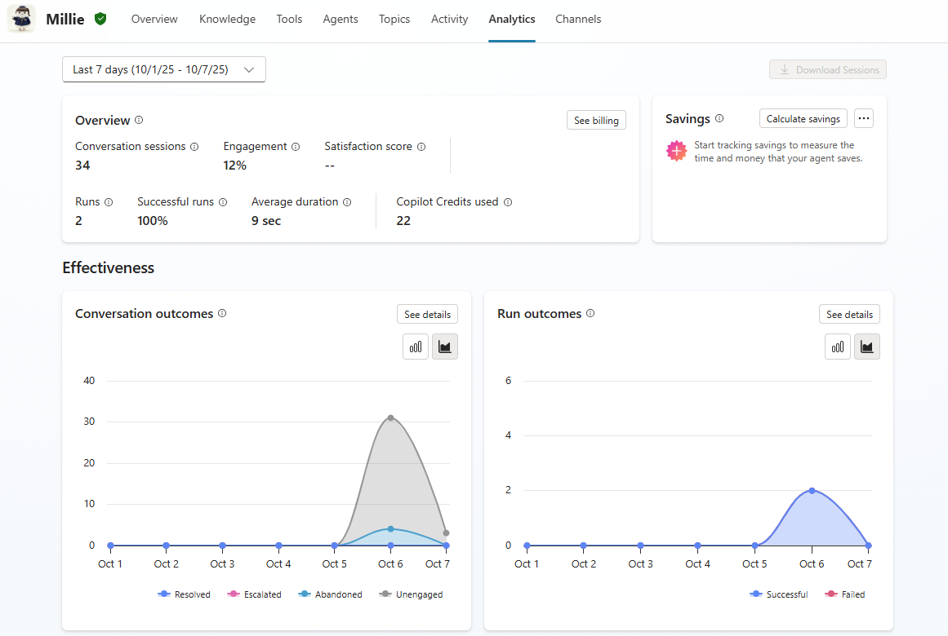
Analytics

Slide 34
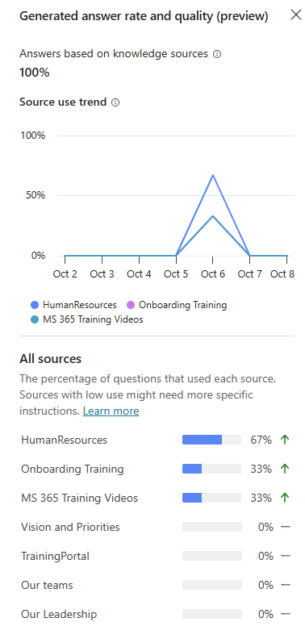
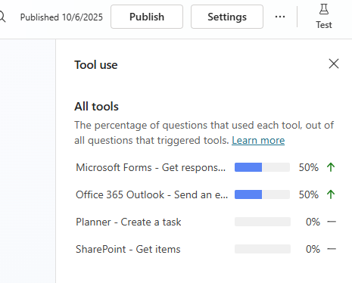
Analytics

Slide 35
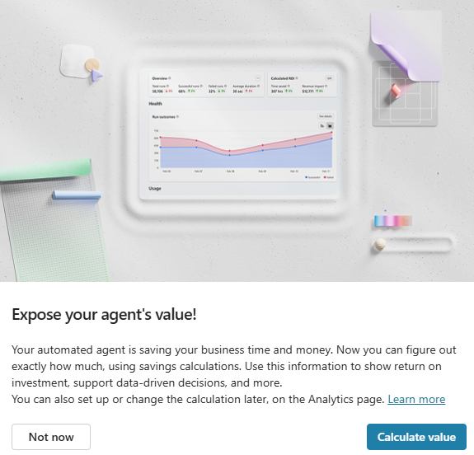
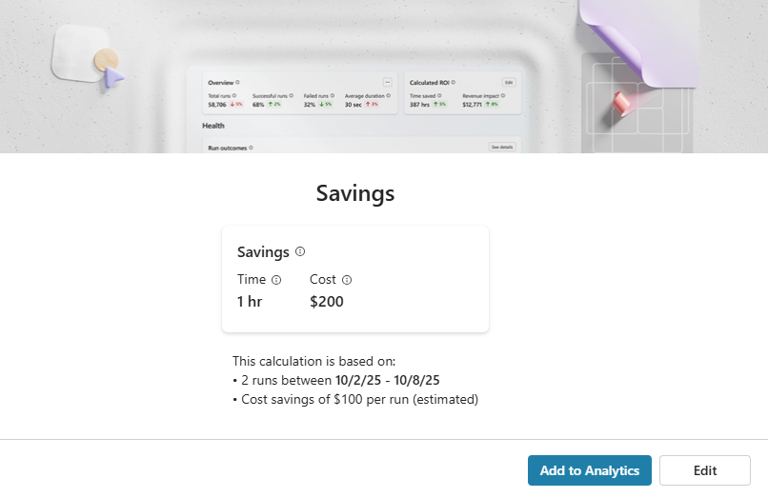
Cost Savings

Slide 36

Governance, Compliance & Billing

Slide 37

Governance
Data hygiene
Enabling / disabling agents for users/user groups
Usage

Slide 38
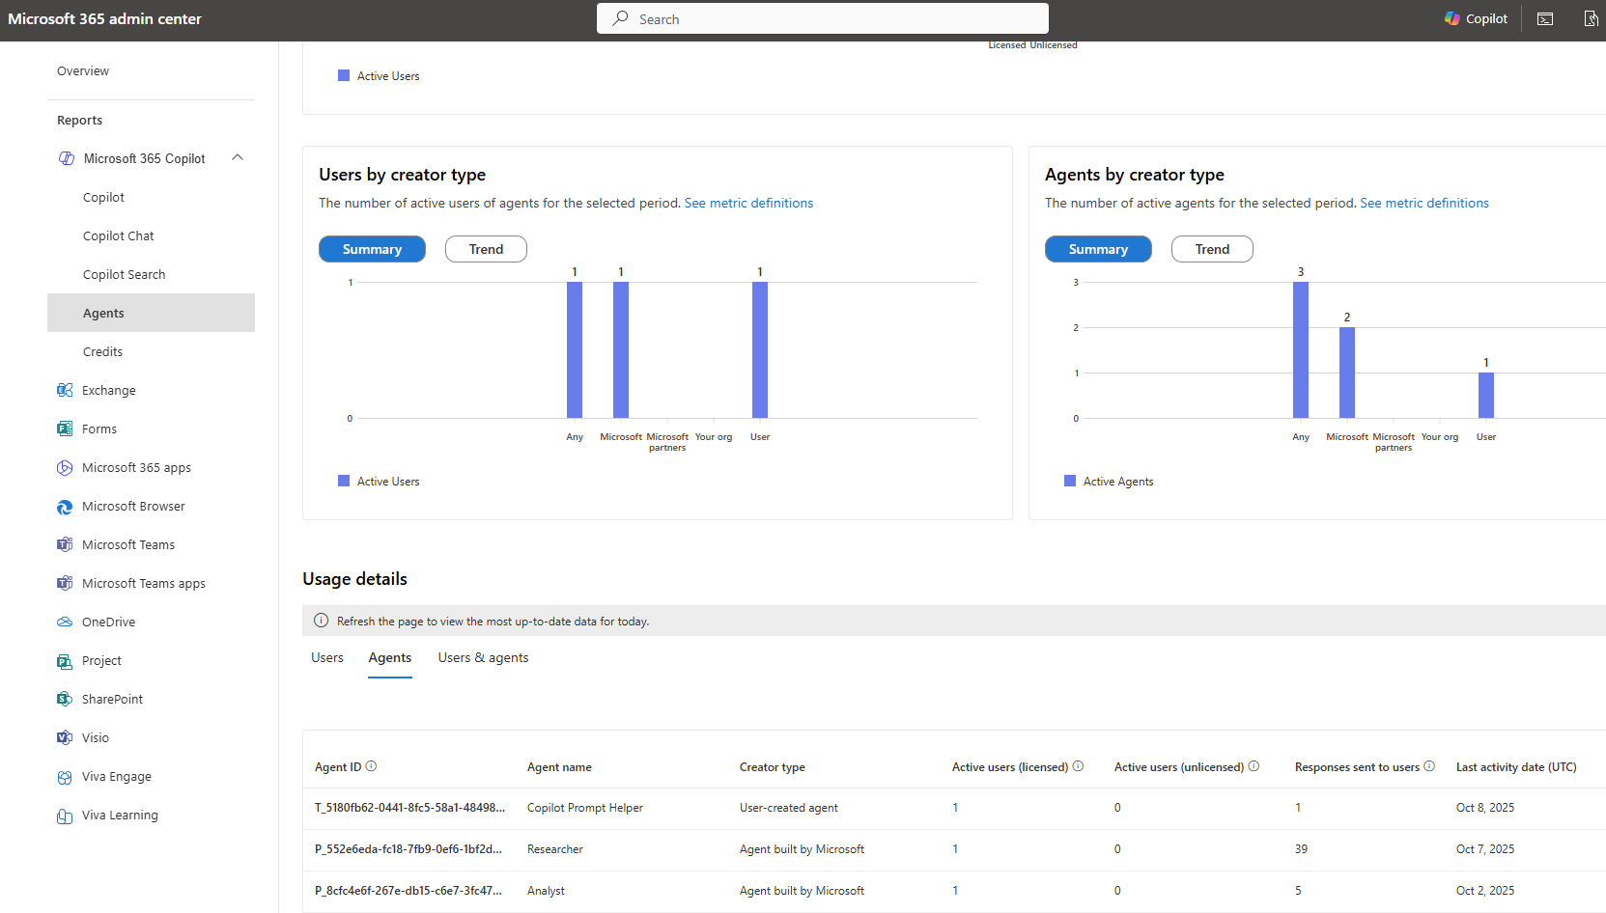
Usage > 365 Admin

Slide 39
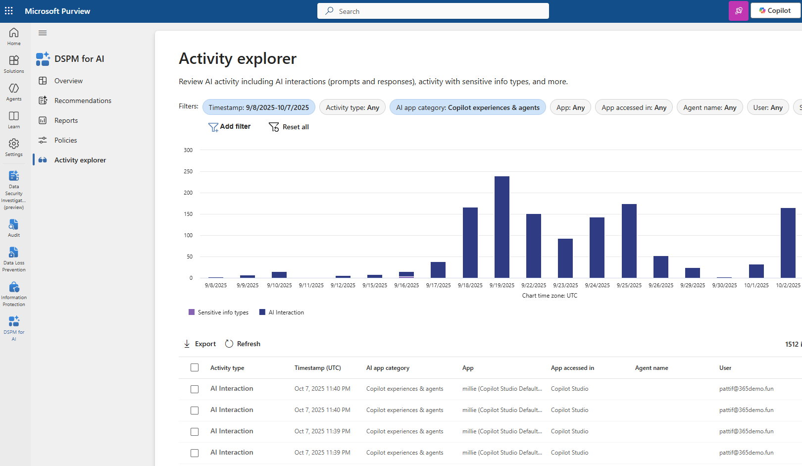
Usage > Purview

Slide 40

Billing Models
Billing Model | Description | Cost Structure | Included Features | Best For
Copilot License (Fixed) | Full Copilot integration across M365 apps (Word, Excel, Teams, etc.) | $30/user/month | Unlimited usage of embedded Copilot features; basic agent access | Users needing daily AI productivity tools across M365 apps
Pay-As-You-Go (PAYG) | Usage-based billing for custom agents and advanced AI scenarios | $0.01/credits Billed per “credits” (unit of agent interaction). | Access to Copilot Chat, SharePoint agents, custom agents via Copilot Studio | Organizations testing agent usage or with variable demand
Prepaid (Message Packs) | Pre-purchase message credits for agent usage | $200 for 25,000 credits/month | Same as PAYG, but with upfront budgeting and cost control | Teams with predictable agent usage needing budget certainty
Annual P3 Plan Message Pack | Annual Pre-purchase message credits for agent usage | $2,850/year for 300,000 credits | Same as Prepaid but yearly | Best for budgeting out with a discounts

Slide 41
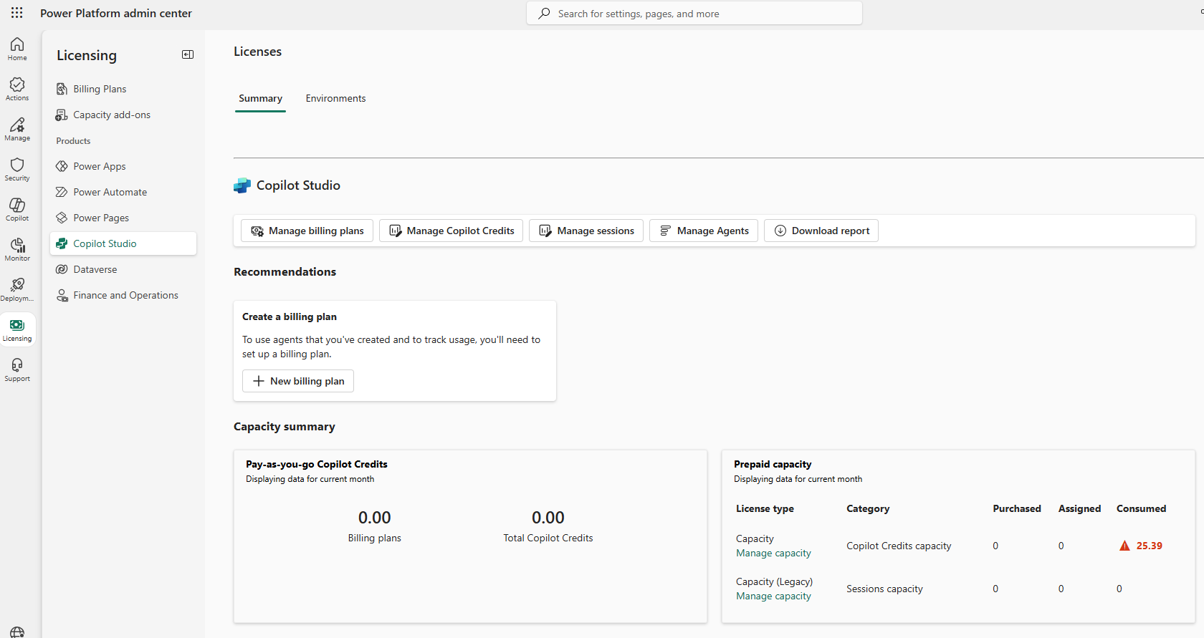
Billing > Power Platform Admin Center

Slide 42

Compliance
Access reviews (permissions etc.)
Additional protections i.e. DLP, sensitivity labeling
DSPM for AI

Slide 43
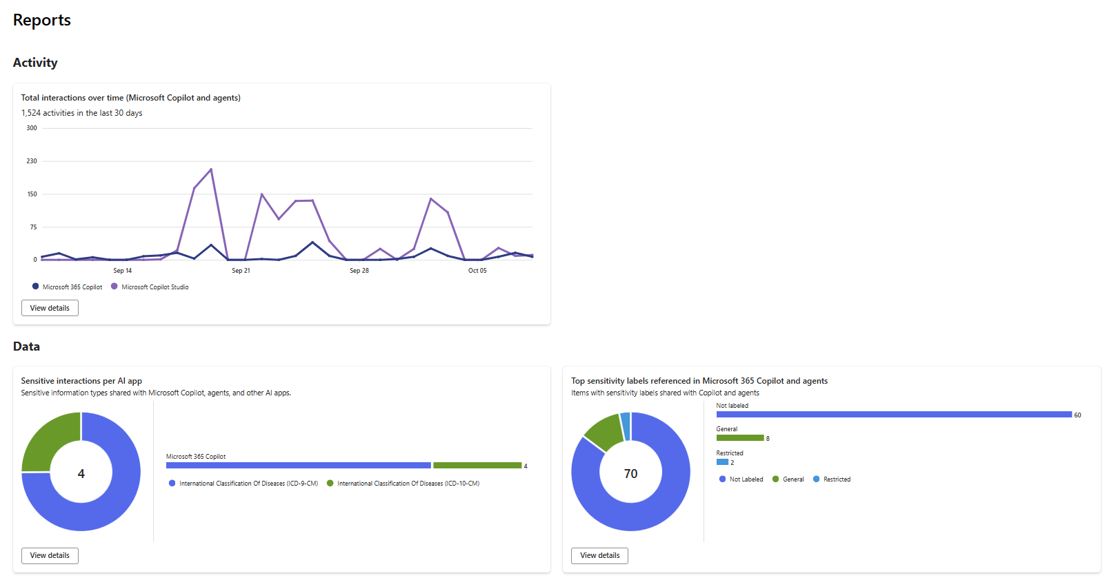
DSPM for AI

Slide 44

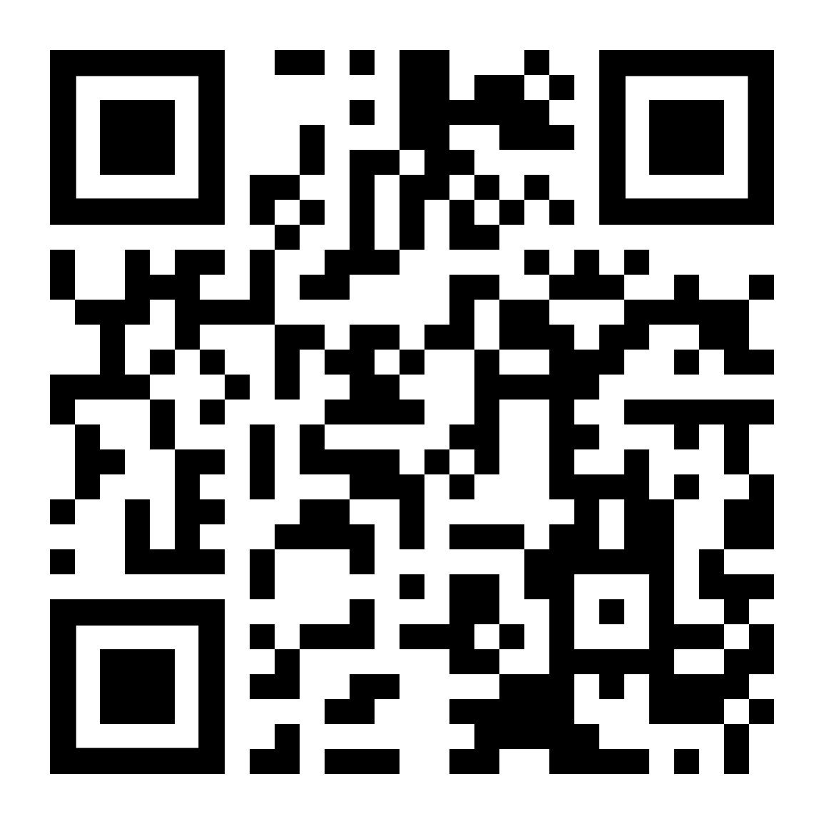
For Resources and More
Session PowerPoint
Sample AI Policy
Agent planning template
Glossary of Terms

Slide 45








Thank You to our Sponsors!
Stop by the Booths for “Vendor Bingo” to win prizes!
PLATINUM(Registration, Breakfast, Lunch)
GOLD
DIGITAL
Minnesota M365 Workshop Day Fall 2025 @M365MN | mn365.org
Notes:
Social Awareness
Please help us drive awareness of the event by tweeting and posting about your sessions and the workshop @mn365 #M365WorkshopDay

Slide 46

Workshop Survey
https://mn365.org/survey
Minnesota M365 Workshop Day Fall 2025 @M365MN | mn365.org

Slide 47
Thank You
Minnesota M365 Workshop Day Fall 2025 @M365MN | mn365.org

