Slide 1

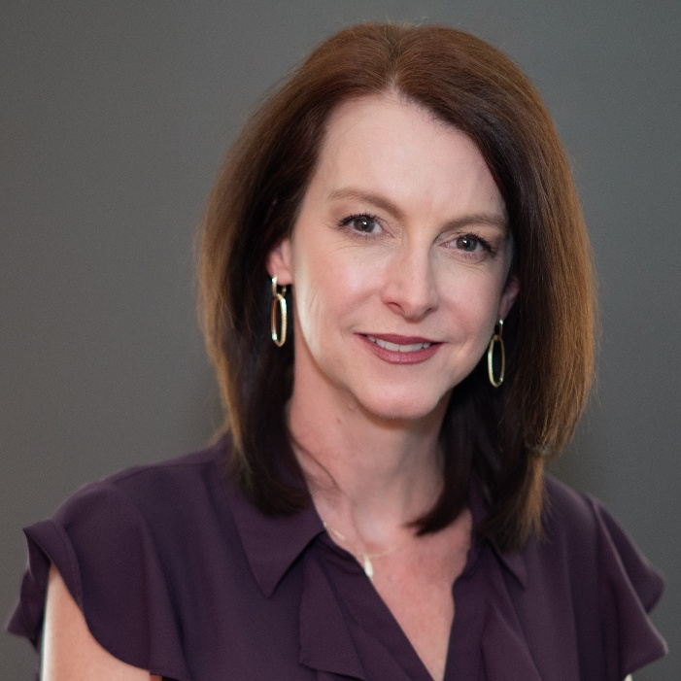


Copilot & Cocktails
Microsoft Copilot
Nina Adams
M365 Consultant
Mytech Partners

Slide 2



Your name, position & company
First or favorite concert
Introductions
Where are you currently in your AI/Copilot journey?

Slide 3







Agenda
Copilot Overview
Prompt examples
Use-cases
Wrap-up & networking

Slide 4

Microsoft Copilot Overview

Slide 5



What is Microsoft Copilot?
AI Assistant built into 365 apps
(E.g., Intern)
Enterprise Data Protection
Works with text, images, datasets and web search…
Create & generate, summarize, track & stay up to date…

Slide 6
Copilot Chat vs Copilot for 365
Feature | Copilot Chat (free) | Copilot for MS 365 (paid)
License | Free (included in Edge) | Requires Copilot license. ($30 p/user p/m)
Purpose | General AI Assistant | Productivity integrated in MS 365 apps
Integration | Standalone (Edge) | Embedded in Word, Excel, Teams, Outlook, PowerPoint, etc.
Data access | No general access to user files (can reference a single file in web app) | Uses your MS 365 content (emails, Teams messages, Office document, calendar etc.)
Best for | Brainstorming, Q&A, summaries | Drafting & generating new content, summarizing, analyzing, creating, tracking etc.
Enterprise Data Protection | Included | Included

Slide 7

Demo
365 Integration

Slide 8

Copilot
Use-Cases

Slide 9

Use-Cases
Leadership: Summarize updates, prep for meetings, create presentations, improve communication
Marketing: Brainstorm campaigns, draft social posts
Finance & Operations: Analyze trends, generate reports, analyze contracts
HR: Draft job descriptions, write policies

Slide 10

Want to learn more?
We offer Copilot training - chat with us!
Try it out on our demo laptops
Contact us to learn more about Copilot training

Slide 11

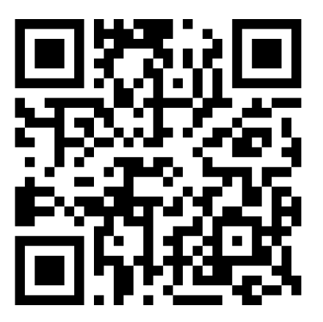


Resources
M365 Champions Community
Mytech YouTube
Channel

Slide 12
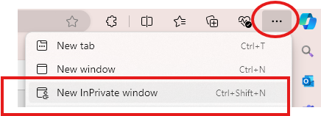
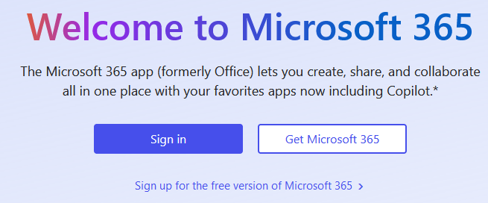
Login Instructions
1. Open Edge > Top right … >
Click ‘New InPrivate window’
Type in ‘www.office.com’ > Click ‘Sign in’

Slide 13
Alias Name | Username / email | Last Name starts with…
Adele Vance | adelev@365demo.fun | A – B
Allan Deyoung | alland@365demo.fun | C – D
Diego Siciliani | diegos@365demo.fun | E - F
Irvin Sayers | irvins@365demo.fun | G - H
Johanna Lorenz | johannal@365demo.fun | I - K
Lee Gu | leeg@365demo.fun | L
Lidia Holloway | lidiah@365demo.fun | M - O
Lynne Robbins | lynner@365demo.fun | P
Megan Bowen | meganb@365demo.fun | R - U
Miriam Graham | miriamg@365demo.fun | V - W
Nestor Wilke | nestorw@365demo.fun | X - Z
Password: !365isfun!

Slide 14

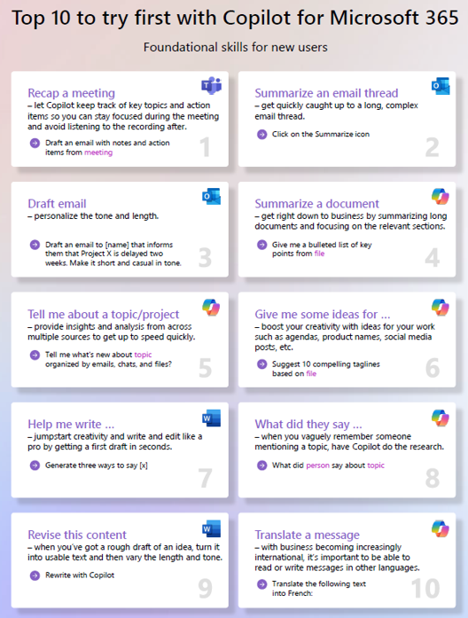
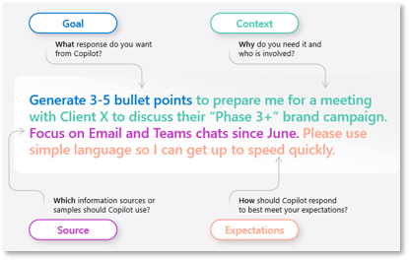
Prompt Elements

Slide 15

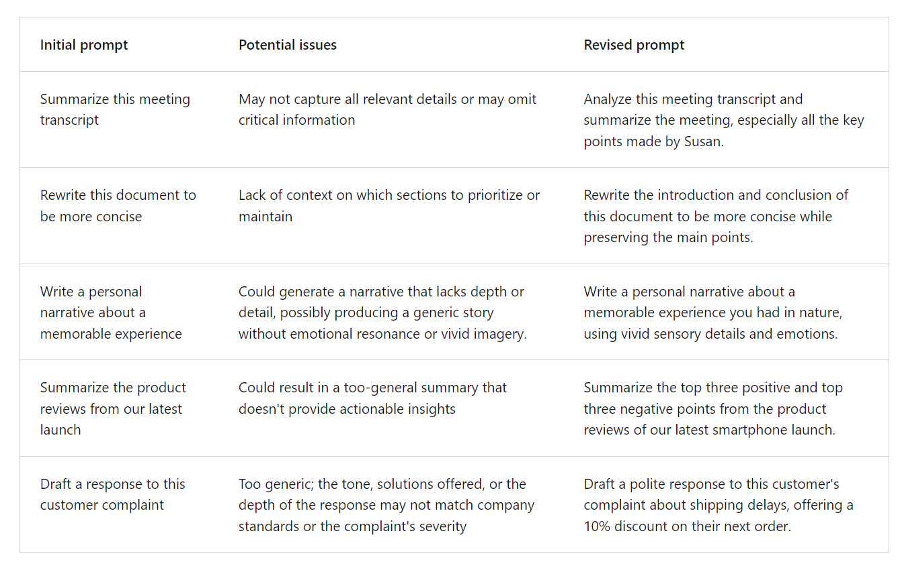
Examples

Slide 16



There are many different roles
You wear many different hats!

Slide 17
RTF FORMAT
ROLE
  You are a Sales Manager / Cyber Security Expert etc.
TASK
  List 5 reasons to adopt Copilot
FORMAT
  Put it in a table format

Slide 18
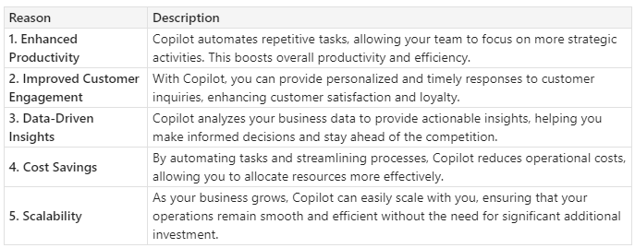
Prompt Example - Sales
Role: Salesperson
Task: 5 reasons why I need Copilot
Format: Table format
“You are a salesperson. Please give me a list of 5 reasons why I need Copilot in my small business. Do it in a table format.”

Slide 19
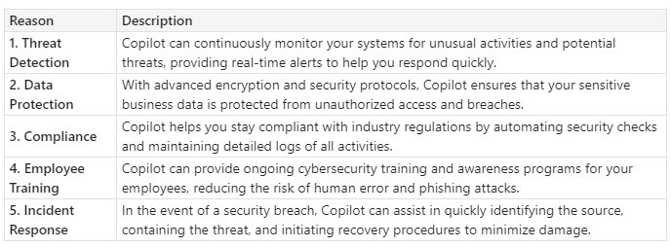
Prompt Example – Security Expert
Role: Cyber Security Expert
Task: 5 reasons why I need Copilot
Format: Table format
“You are a Cyber Security Expert. Please give me a list of 5 reasons why I need Copilot in my small business. Do it in a table format.”
Same prompt, different ‘Role’

Slide 20
Copilot wears many hats too!
Create a Training Presentation
Generate a report for a different team/client
Follow Up Email/ Action Items
Generate Sales
Quote Wording
Teams Meeting​
How-to Technical Document

Slide 21



Do’s
Don’ts
Be clear and specific
  Provide topic, purpose, tone and length
Provide details
  Provide contextual details to help it generate more accurate responses for e.g. ‘Role’.
Reference content / give examples
  E.g. key phrases, document or website references etc.
Check for accuracy!
  Always check Copilot’s responses
Be vague
Use slang or jargon
Give conflicting instructions
Interrupt or change topics abruptly

