Slide 1

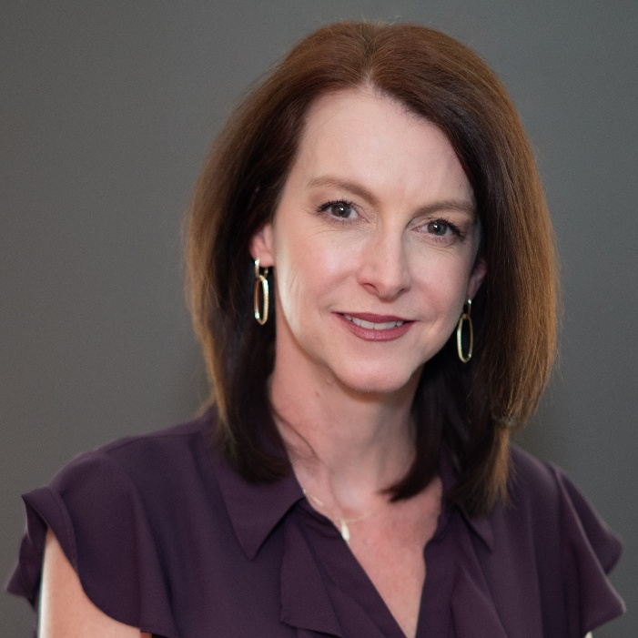


Client Immersion Experience
Microsoft Copilot
Nina Adams
M365 Consultant
Mytech Partners

Slide 2



Your name, position & company
First or favorite concert
Introductions
Where are you currently in your AI/Copilot journey?

Slide 3








Agenda
Demo environment overview
Prompt tips &
tricks
Copilot by
Application
  Login instructions
  Prompt formats
  Prompt Do’s and Don’ts
  Try Copilot in Microsoft 365 applications
Examples by Department
Wrap-up &
networking
  Use-cases by department
  Scenario library
  More Resources
  Connect with us

Slide 4
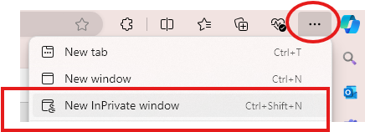

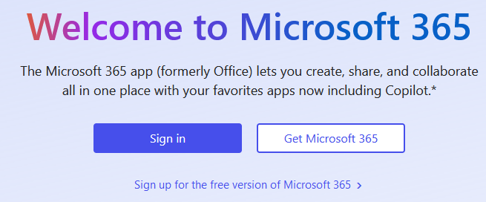


Login Instructions
1. Open Edge > Top right … >
Click ‘New InPrivate window’
Type in ‘www.office.com’ > Click ‘Sign in’

Slide 5
Alias Name | Username / email | Last Name starts with…
Adele Vance | adelev@365demo.fun | A – B
Allan Deyoung | alland@365demo.fun | C – D
Diego Siciliani | diegos@365demo.fun | E - F
Irvin Sayers | irvins@365demo.fun | G - H
Johanna Lorenz | johannal@365demo.fun | I - K
Lee Gu | leeg@365demo.fun | L
Lidia Holloway | lidiah@365demo.fun | M - O
Lynne Robbins | lynner@365demo.fun | P
Megan Bowen | meganb@365demo.fun | R - U
Miriam Graham | miriamg@365demo.fun | V - W
Nestor Wilke | nestorw@365demo.fun | X - Z
Password: !365isfun!

Slide 6


Copilot, not Autopilot
Disclaimer…
Share!
Experiment!

Slide 7

Prompting
tips &
tricks

Slide 8

Prompt Elements
A clear ‘ask’
Context
Desired output
Examples (if applicable)
Conversational follow-ups

Slide 9
Example
Please write a job description for a Senior Program Manager at a non-profit.
A clear ‘ask’
Include key responsibilities, skills & qualifications. Use (org website) for additional context.
Context
Desired output
Output should be a MS Word document.
Examples (if applicable)
Use this format (attach job description template).
Conversational follow-ups
Please add KPIs for this role.

Slide 10

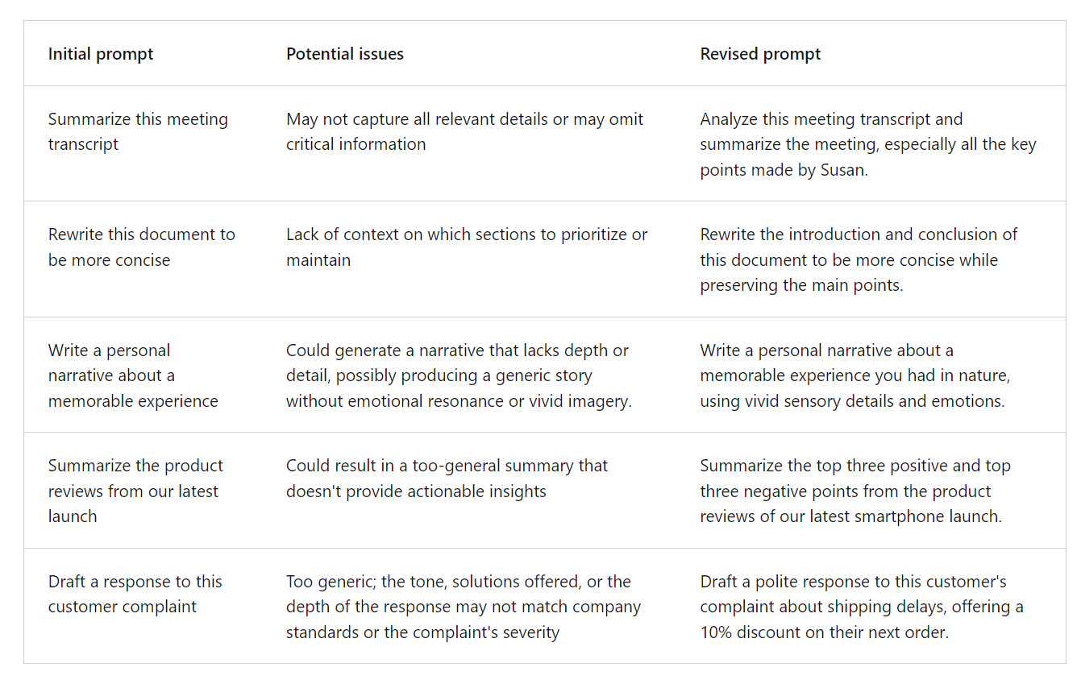
Examples

Slide 11




MS365 integration = Many possibilities
Create a Training Presentation
Generate a report for a different team/client
Follow Up Email/ Action Items
Generate Sales
Quote Wording
Teams Meeting​
How-to Technical Document

Slide 12



Do’s
Don’ts
Be clear and specific
  Provide topic, purpose, tone and length
Provide details
  Provide contextual details to help it generate more accurate responses for e.g. ‘Role’.
Reference content / give examples
  E.g. key phrases, document or website references etc.
Check for accuracy!
  Always check Copilot’s responses
Be vague
Use slang or jargon
Give conflicting instructions
Interrupt or change topics abruptly

Slide 13

Copilot by
Application

Slide 14



APPLICATION TRAINING
Copilot in Edge
Notes:
Across

Slide 15

Copilot in Edge
Prompts to try…
Generate an image of [ ] Generate an email about [ ] to [audience]. The tone should be [ ]. Include the following details [ ]. Summarize key points of [file], [meeting], [emails]. Use bullet points / table etc. What should be on my radar from emails / chats last week? What’s the lates from [person name or topic], organized by emails, chats and files?

Slide 16
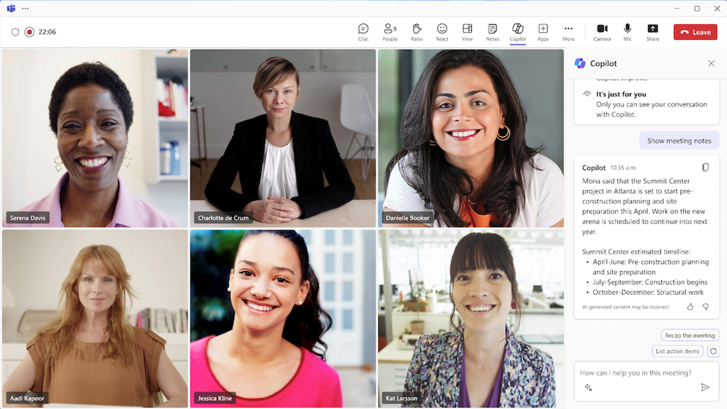

APPLICATION TRAINING
MS Teams

Slide 17

MS Teams
Prompts to try…
Recap the meeting. Create a list of action items. Convert to a table. Draft an email to the meeting participants that summarized the meeting and includes the action items.
For each participant, what was the biggest concern? What questions were asked, answered, and unresolved? What's the latest from /person, organized by emails, chats, and files?
Summarize Teams messages where I was @mentioned this week
Help me prepare for my meeting with [ ] tomorrow.

Slide 18
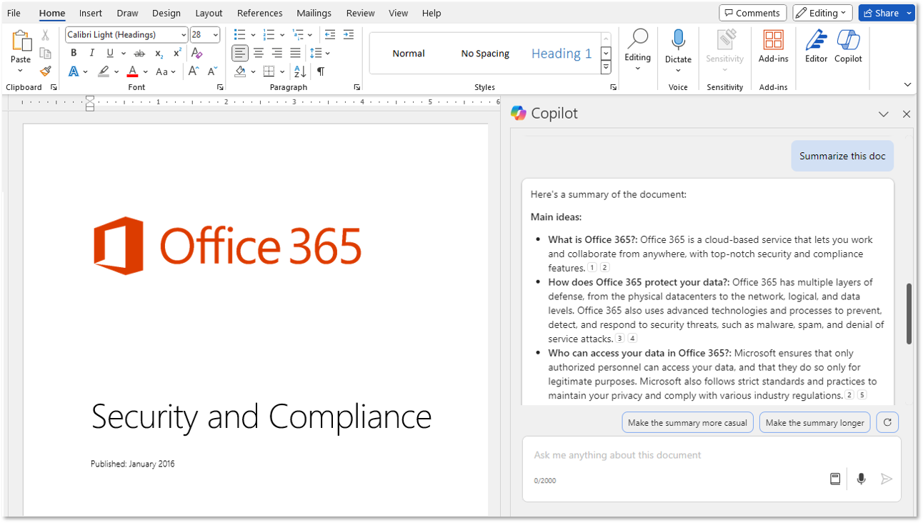

APPLICATION TRAINING
MS Word

Slide 19
MS Word
Prompts to try…
JOB DESCRIPTION: I am the manager of [department ]and need to write a detailed job description / role alignment card so that we can hire a [role].
WRITING A GRANT APPLICATION Attach the grant opportunity (‘Sample-Grant-Proposal.pdf’). Prompt 1: Role: I am the development manager at a non-profit. Task: Need to write a compelling grant application based on the attached document. Format: a typical grant application format. Prompt 2: Rewrite the 'Statement of Need' to be more compelling.
ASK QUESTIONS: How to I add a table of contents? How do I add page numbers?

Slide 20
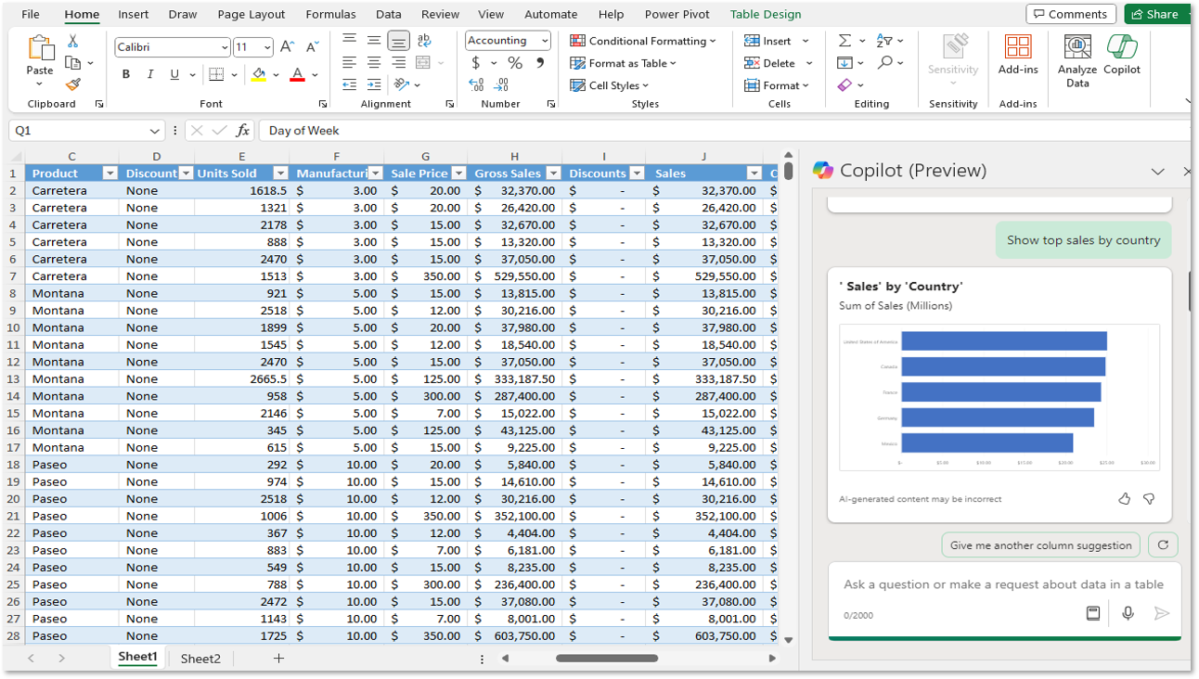

APPLICATION TRAINING
MS Excel

Slide 21
MS Excel
Prompts to try…
Show insights / Add all insights to grid
Summarize the data using a pivot table. Show total [ ] by [ ].
Create a bar chart showing [ ].
Look at [COLUMN NAME]. Add a new column with a formula that [ ]. (Add the column)
Look at ‘Date’. Highlight all dates before 2025.

Slide 22
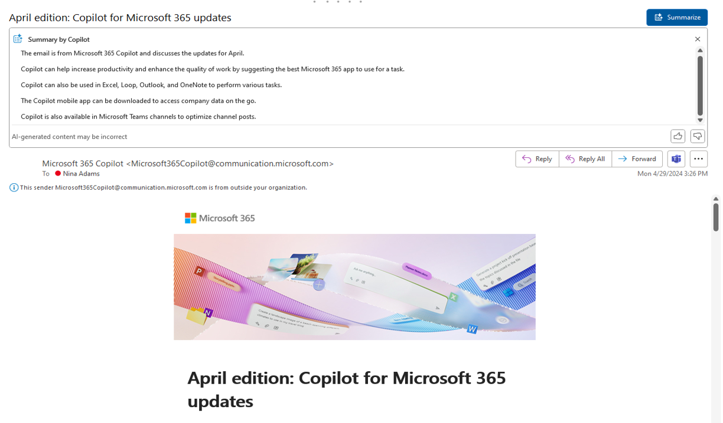

APPLICATION TRAINING
MS Outlook

Slide 23

Outlook
Prompts to try…
Try the ‘Draft with Copilot’ option
Summary by Copilot
Coaching by Copilot
Reply
Schedule with Copilot

Slide 24
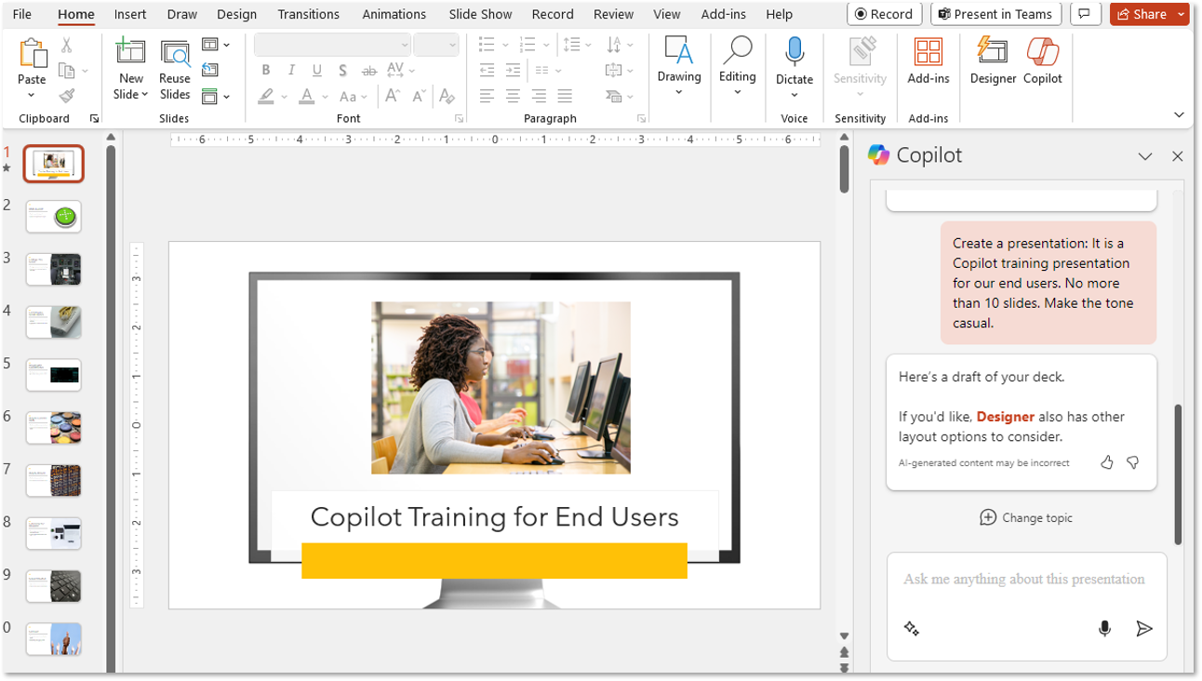

APPLICATION TRAINING
MS PowerPoint

Slide 25
MS PowerPoint
Prompts to try…
Use [FILE NAME ]to ‘Create a presentation from file’
Add ‘agenda’ or ‘thank you’ slide
Organize the presentation
Check out ‘View Prompts’ button on topic bar for more suggestions
WORKING WITH EXISTING CONTENT Summarize this presentation Are there any actions, date or deadlines in this presentation?

Slide 26

USE-CASES FOR NON-PROFITS

Slide 27

EXECUTIVE DIRECTORS / LEADERSHIP
Strategic Planning: Summarize board meeting notes, draft strategic plans, and analyze donor trends.
Grant Writing: Generate first drafts of grant proposals or letters of inquiry.
Speech Writing: Draft speeches or talking points for events and fundraisers.
Tracking / staying up to date on projects or initiatives

Slide 28

FUNDRAISING & DEVELOPMENT
Donor Management & Communications: Track donations & trends, draft thank-you letters, newsletters, and campaign emails.
Grant Management: Summarize grant requirements, generate grant proposals and reports.
Event Planning: Create timelines, checklists, and promotional materials.

Slide 29

PROGRAM MANAGERS
Impact Reporting: Summarize program outcomes and generate reports for stakeholders.
Training Materials: Create guides, presentations, and FAQs for volunteers or staff.
Data Analysis: Analyze survey results or program data to identify trends.

Slide 30

MARKETING & COMMUNICATIONS
Social Media Content: Generate posts, captions, and campaign ideas.
Press Releases: Draft announcements and media outreach emails.
Website Content: Rewrite or optimize content for clarity and SEO.

Slide 31

HR, FINANCE & OPERATIONS
Budgeting: Create templates, summarize financial reports, and forecast expenses.
Policy Drafting: Draft internal policies or procedures.
Vendor Contracts & Communications: Write professional emails or RFPs.
HR Activities: Job descriptions, role-alignment cards, employee handbooks.

Slide 32

VOLUNTEER MANAGEMENT
Recruitment Materials: Draft flyers, emails, and onboarding documents.
Event Follow-Up: Generate thank-you notes and feedback surveys.
Volunteer Coordination: Track volunteer engagement, skills etc.

Slide 33

AI Nonprofit use cases
“A day in the life…”
Overview and opportunities
Use case by role
Day in the life
AI holds tremendous potential for nonprofit organizations. Discover key opportunities and learn how AI can assist.
Copilot can enhance the tasks that nonprofit users perform every day. Explore key use cases and how Copilot and agents can assist along the way.
See how real-life nonprofit users are leveraging Copilot day-to-day.

Slide 34





Funding research and grant proposal writing
Nonprofit
Microsoft 365 Copilot
Buy
With limited resources, Nonprofit organizations can benefit from AI assistance in all aspects of fundraising from researching sources to drafting grant proposals.
Identify funding sources
Conduct market research
Analyze data
Discover potential funding sources by identifying potential grants that match your nonprofit’s needs.
Use Business Chat for Web to search for relevant data sources such as industry reports, government statistics, and market analysis articles.
Use Copilot in Excel to analyze donor preferences and generate insights. Organize donor data into an Excel sheet with columns for donor name, donation amount, frequency, preferred causes, and demographics.
Copilot Chat¹
Copilot Chat¹
Copilot in Excel
Example prompt: Search for government agencies, foundations, and corporations that offer grants for [your nonprofit’s mission or project type]. Provide details on eligibility criteria, application deadlines, and funding amounts.
Example prompt: Search and summarize recent reports on funding trends and donor preferences [your industry] and summarize findings.
Example prompt: Create a PivotTable to summarize donor preferences by cause and average donation amount.
KPIs impacted
Fundraising ROI
Craft customized emails
Draft your proposal
Create data visualizations
Craft compelling emails to send to potential funders with the details of your proposal.
Prompt Copilot in Word to create a grant proposal, incorporating key insights and data visualizations.
Use Copilot to analyze the data and create visual reports to summarize your findings.
Value benefit
Cost savings
Copilot Chat²
Copilot in Word
Copilot in Excel
Employee experience
Example prompt: Draft an email to [funder’s name] introducing my nonprofit and expressing interest in their grant program. Highlight key points from /[proposal in Word].
Example prompt: Create a grant proposal for [your nonprofit’s project], including an executive summary, needs statement that references insights from /[project plan.docx], project description, budget, and organization information.
Example prompt: Create a bar chart to visualize the distribution of donor preferences across different causes over the last five years.

Slide 35

Manage the donor pipeline
Nonprofit
Microsoft 365 Copilot
Buy
Creating personalize messages to donors can increase fundraising effectiveness and Copilot can help with everything from analyzing data to writing creative emails.
Identify trends and patterns
Segment and score prospects
Personalize messaging
Leverage Copilot in Excel to analyze data. Import data from various sources to identify trends and patterns in donor behavior, helping to pinpoint potential prospects.
Categorize prospects based on specific criteria and assign scores to prioritize them.
Based on the insights gained from data analysis, draft personalized messages for each donor segment.
Copilot in Excel
Copilot in Excel
Copilot in Outlook
Example prompt: Create a summary table showing total donations by donor for the
past year.
Example prompt: Assign a score to each prospect based on their donation frequency and average donation amount.
Example prompt: Write an email message using a warm tone thanking the donor for making more than $1,000 in donations
last year.
KPIs impacted
Fundraising ROI
Manage pipeline
Track interactions with potential donors and partners, providing insights into the best times to reach out and the most effective communication strategies.
Value benefit
Cost savings
Copilot Chat¹
Employee experience
Example prompt: Summarize recent interactions with [donor name] and suggest follow-up actions.

Slide 36


Optimize program performance
Nonprofit
Microsoft 365 Copilot
Buy
Tracking program performance and collaborating on improvements is easier with Copilot.
Analyze performance data
Identify improvement areas
Create program reviews
Analyze performance data, generating insights and identifying key metrics. Use Excel formulas and functions to calculate performance indicators.
Pinpoint areas where performance can be optimized. Create charts and graphs to highlight improvement opportunities.
Use Word to draft comprehensive reviews of existing programs, summarizing key performance metrics and feedback from stakeholders.
Copilot in Excel
Copilot in Excel
Copilot in Word
Example prompt: Create a bar chart based on the latest performance data in the /[performance data.xlsx]
Example prompt: Highlight cells that show performance metrics hitting below identified benchmarks.
Example prompt: Generate a program review using the key performance metrics, identified improvement areas, and the latest stakeholder feedback from the /[program reporting deck.ppt]
KPIs impacted
Program impact
Create implementation plan
Document program goals
Ensure team alignment
Use Copilot in PowerPoint to create a presentation that summarizes the implementation plan and detailed action steps for program changes.
Use Copilot in Word to help draft up and document an implementation plan that can be referenced and shared by team members.
Use Copilot in Microsoft Teams to summarize key points and action items from weekly/monthly program syncs.
Value benefit
Cost savings
Copilot in PowerPoint
Copilot in Word
Copilot in Teams
Employee experience
Example prompt: Create a PowerPoint presentation using the /[program goals outline] to showcase goals and next steps.
Example prompt: Draft an outline that summarizes program objectives, key performance metrics, recent achievements, and next steps using key points and action items gathered from /[program sync meeting notes] and /[program review document/docx].
Example prompt: Summarize key points and action items from the last program sync.

Slide 37
Optimize staff and volunteer planning
Nonprofit
Microsoft 365 Copilot
Buy
Nonprofit organizations need to operation efficiently and Copilot can help to assess staffing needs and assist with recruiting plans and training.
Assess current staffing
Identify gaps
Develop a recruitment plan
Evaluate current staffing to understand the existing skills, roles, and gaps.
Use Copilot in Excel to help visualize current staffing/volunteer needs.
Create a recruitment plan to fill identified gaps and meet future staffing/volunteer needs.
Copilot in Word
Copilot in Excel
Copilot in Word
Example prompt: Create a report that describes our current workforce across departments, roles, and skills using the information captured in the /[resource management document.docx]
Example prompt: Highlight cells where staffing/volunteer hours are below required hours.
Example prompt: Outline a recruitment plan to address identified staffing gaps and future needs. Include strategies for sourcing candidates, timelines, and key milestones based on past /[recruitment strategy plan.docx]
KPIs impacted
Program impact
Evaluate and adjust
Evaluate staff performance
Create training programs
Volunteer retention
Continuously adjust staffing and volunteer plans based on feedback and data to ensure optimal staffing levels.
Regularly monitor and evaluate staff and
volunteer utilization to ensure alignment with organizational goals.
Develop and implement training programs to upskill current staff members and volunteers.
Value benefit
Cost savings
Copilot in Teams
Copilot in Excel
Copilot Chat²
Employee experience
Example prompt: Summarize regular meetings to review workforce performance data and gather feedback from team members.
Example prompt: Tell me what data is required to calculate Key Performance Indicators (KPIs) such as overtime hours, peak interval staffing levels, and skill utilization.
Example prompt: Create a training outline for our new development program, covering required skills and competencies.

Slide 38
Marketing campaign planning and design
Nonprofit
Microsoft 365 Copilot
Buy
Nonprofit organizations can use AI to help develop marketing plans from analyzing trends, to getting creative ideas, to creating catchy social media posts.
Analyze and forecast trends
Develop visual insights
Create an email nurture campaign
Analyze donation trends and forecast the best times to approach donors. Segment donors based on their giving history, frequency, and amount.
Visualize average funding amounts and suggest the ideal donation request amounts based on past donor behavior and demographic data.
Use Copilot in Outlook to draft tailored emails to potential donors that request the identified ideal donation amount.
Copilot in Excel
Copilot in Excel
Copilot in Outlook
Example prompt: Create a table of donations by month.
Example prompt: Use historical donor data to generate a line graph for donation amounts
over time.
Example prompt: Draft an email that will be sent to [potential donor’s name], outlining the new campaign and including the benefits of the campaign and benefits for the donor using the /[marketing campaign plan.docx].
KPIs impacted
Program impact
Adapt in real time
Develop a social media campaign
Conduct market research
Fundraising ROI
Evaluate reception to campaign and prompt Copilot to revise messaging according to relevant developments.
Create tailored social posts to publish on each of your communication channels to drive engagement with potential donors.
Gather valuable information about potential donors who you may not have a pre-existing relationship with, including their funding preferences and behaviors.
Value benefit
Cost savings
Copilot Chat²
Copilot Chat²
Copilot Chat²
Employee experience
Example prompt: Revise these social media posts to incorporate new developments in the area, including.
Example prompt: Create six social media posts based on /[market research document]. The posts should highlight key insights and trends relevant to our nonprofit's mission and programs. Each post should be engaging, informative, and tailored to our target audience.​
Example prompt: Identify potential donors who have shown a propensity to fund programs or causes similar to those of our nonprofit organization. Provide insights into their giving patterns, preferences, and any relevant demographic information.

Slide 39
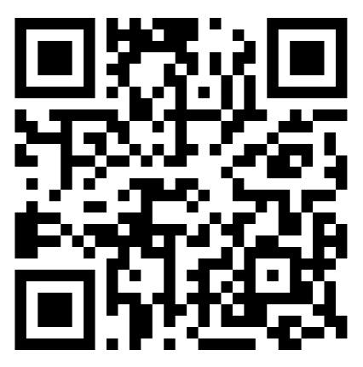
Resources
M365 Champions Community
Mytech YouTube
Channel

