Slide 1

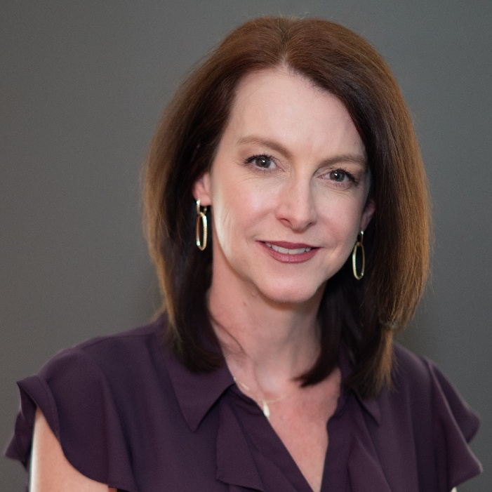


Client Immersion Experience
Microsoft Copilot Chat
Nina Adams
M365 Consultant
Mytech Partners

Slide 2







Agenda
Copilot Overview
Prompt examples
Use-cases
Wrap-up

Slide 3

What’s one administrative task you wish someone else could do for you?

Slide 4



Write a report?
Summarize a document?
Compose an email or draft a policy?
Analyze a spreadsheet?
Conduct
research?

Slide 5

What is Copilot Chat?
Think of it as your ‘helpful intern’
Where to access it: www.office.com > Chat
Enterprise Data Security
PROMPT: “I’m new to Copilot. Can you give me a few basic ideas of things I can do?”

Slide 6

Examples…
  Summarize documents, web pages, etc.
  Draft reports, policies etc.
  Analyze data
  Learning, research, brainstorm ideas (including ‘Google type’ searches)
Generate images

Slide 7

How to talk to Copilot

Slide 8

Prompt Elements
A clear ‘ask’
Context
Desired output
Examples (if applicable)
Conversational follow-ups

Slide 9
Example
Please write a job description for a Senior Program Manager at a non-profit.
A clear ‘ask’
Include key responsibilities, skills & qualifications. Use (org website) for additional context.
Context
Desired output
Output should be a MS Word document.
Examples (if applicable)
Use this format (attach job description template).
Conversational follow-ups
Please add KPIs for this role.

Slide 10
DEMO

Slide 11

USE-CASES FOR NON-PROFITS

Slide 12

EXECUTIVE DIRECTORS / LEADERSHIP
Strategic Planning: Summarize board meeting notes, draft strategic plans, and analyze donor trends.
Grant Writing: Generate first drafts of grant proposals or letters of inquiry.
Speech Writing: Draft speeches or talking points for events and fundraisers.

Slide 13

FUNDRAISING & DEVELOPMENT
Donor Management & Communications: Track donations & trends, draft thank-you letters, newsletters, and campaign emails.
Grant Management: Summarize grant requirements, generate grant proposals and reports.
Event Planning: Create timelines, checklists, and promotional materials.

Slide 14

PROGRAM MANAGERS
Impact Reporting: Summarize program outcomes and generate reports for stakeholders.
Training Materials: Create guides, presentations, and FAQs for volunteers or staff.
Data Analysis: Analyze survey results or program data to identify trends.

Slide 15

MARKETING & COMMUNICATIONS
Social Media Content: Generate posts, captions, and campaign ideas.
Press Releases: Draft announcements and media outreach emails.
Website Content: Rewrite or optimize content for clarity and SEO.

Slide 16

HR, FINANCE & OPERATIONS
Budgeting: Summarize, analyze & create visualizations from spreadsheets.
Policy Drafting: Draft policies or procedures.
Vendor Communication: Write professional emails or RFPs.
HR Activities: Job descriptions, role-alignment cards, employee handbooks.

Slide 17

VOLUNTEER MANAGEMENT
Recruitment Materials: Draft flyers, emails, and onboarding documents.
Event Follow-Up: Generate thank-you notes and feedback surveys.
Volunteer Coordination: Track volunteer engagement, skills etc.

Slide 18
1-4 Take-Aways

Slide 19

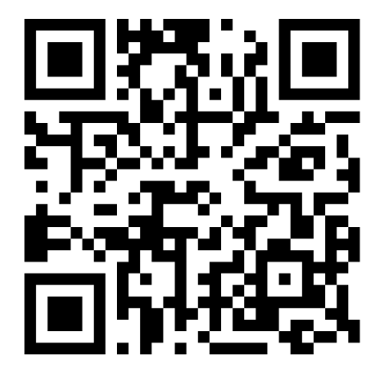


Resources
M365 Champions Community
Mytech YouTube
Channel

