Slide 1
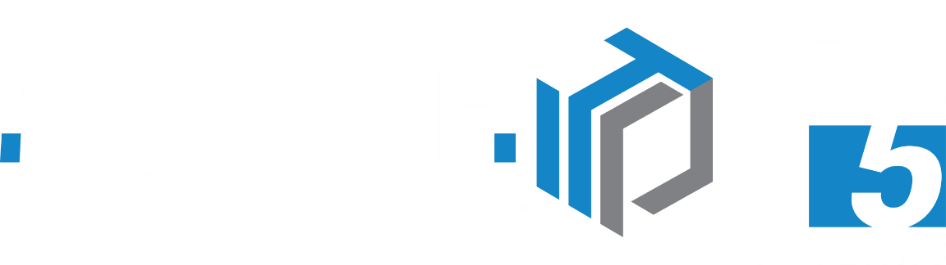
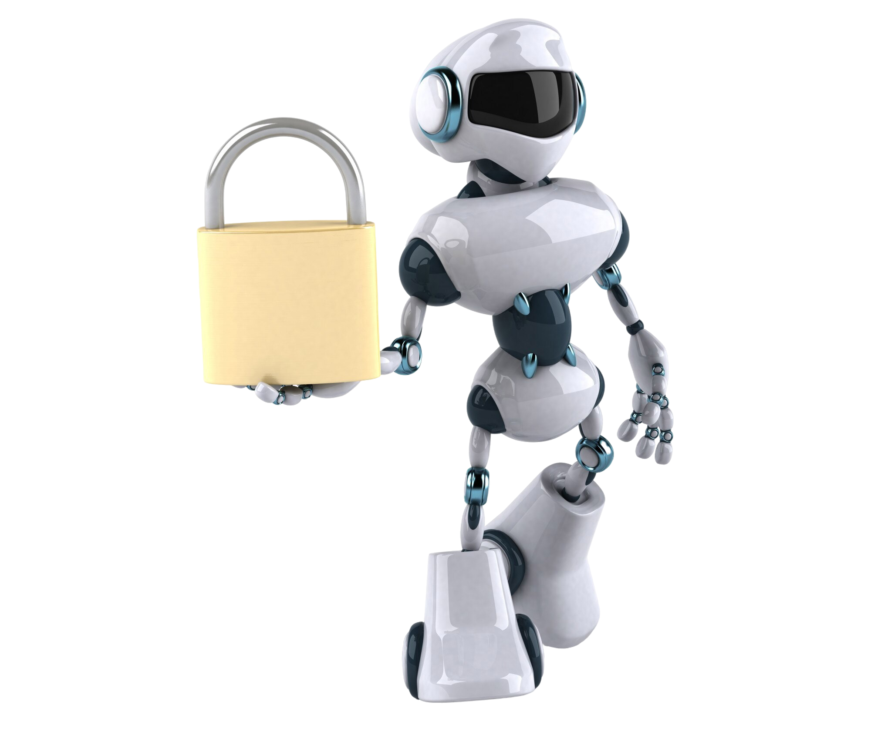
MYTECH PARTNERS · WEBINAR
Secure AI
One platform. Every AI model. Built-in governance.

Slide 2
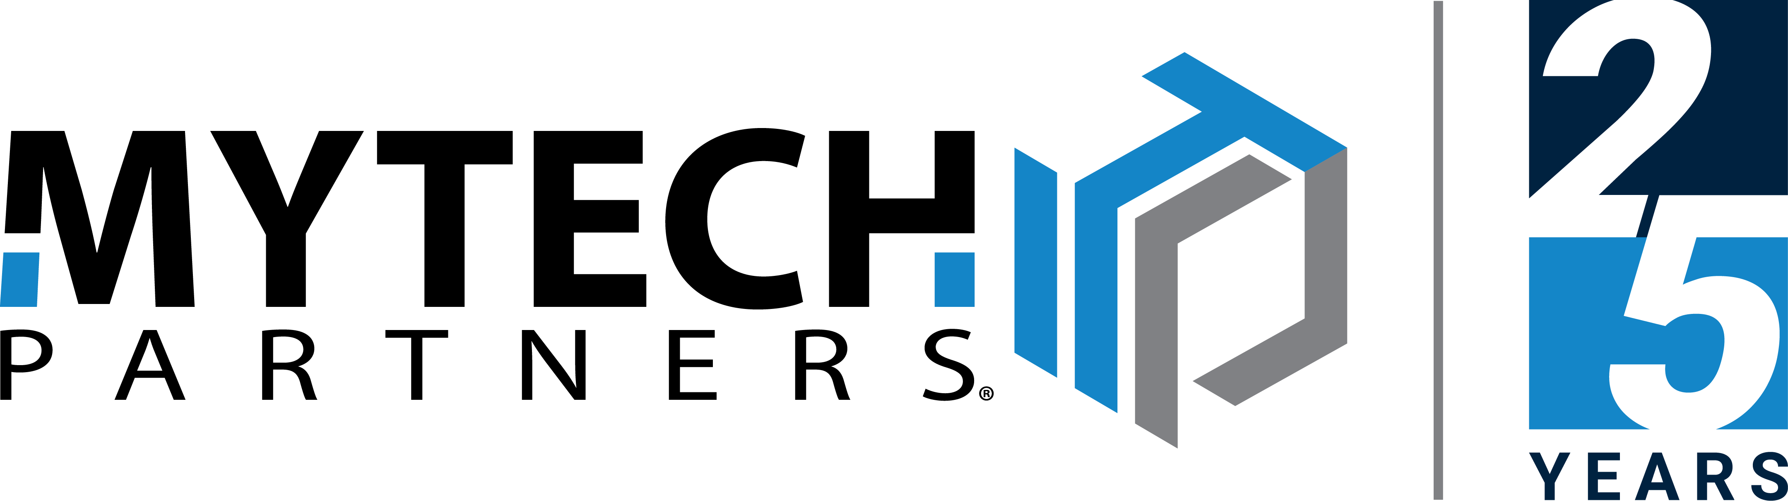

OVERVIEW
Agenda
What we'll cover today.
01
02
The AI Reality
See It In Action
› Why Now? The urgency
› Platform Walkthrough
› 3 Critical Challenges
› Q&A + Next Steps
› What Is Secure AI?
› Key Features

Slide 3
WHY NOW
The AI moment is already here.
75%
4x
$2,400
of knowledge workers
faster data exposure
avg annual waste per user
already use AI at work — most without IT approval
Sensitive data shared with public AI tools in seconds, not days
from uncoordinated, overlapping AI subscriptions

Slide 4
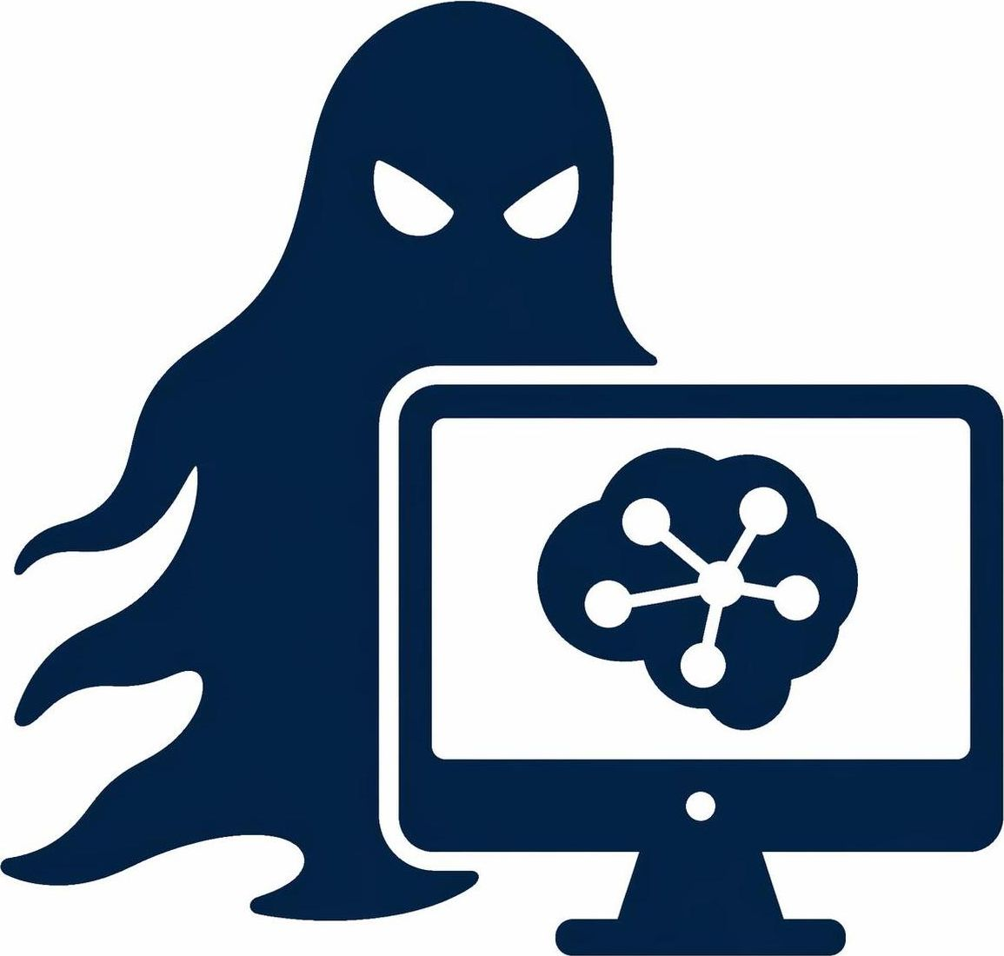

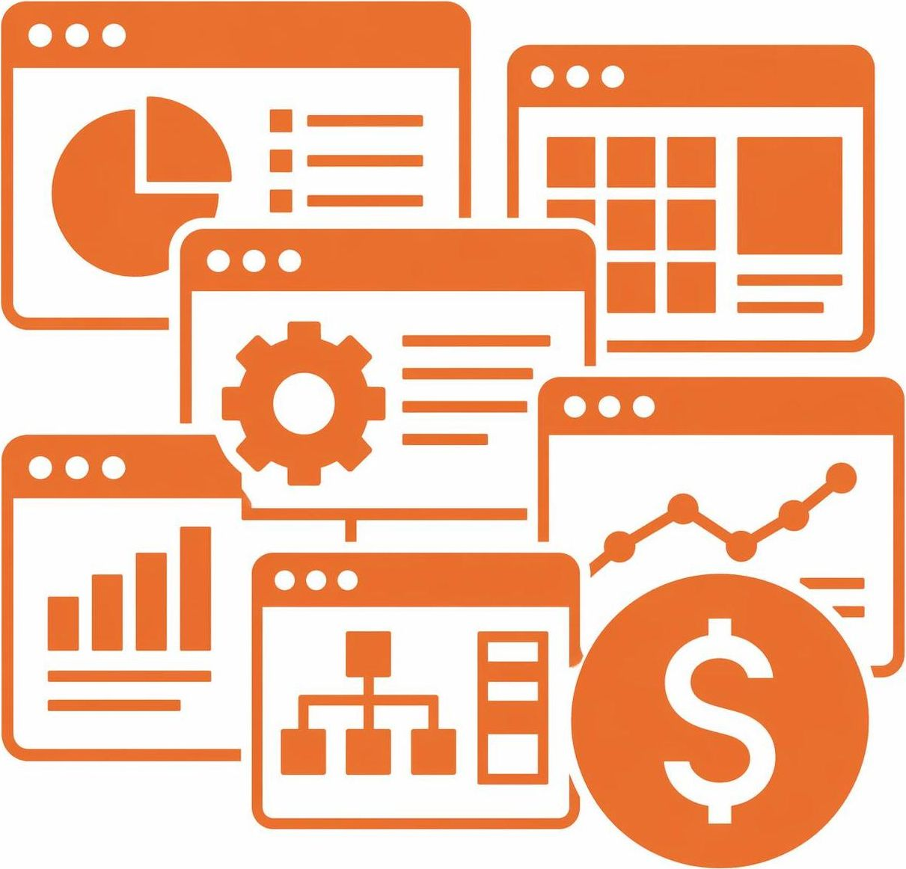
THE AI REALITY IN MOST ORGANIZATIONS
3 Critical Challenges
What we see every day in organizations like yours
01
02
03
Shadow AI Tools
Governance, Risk and Liability
Tool Sprawl & Cost
Employees are already using AI, ChatGPT, Gemini, Copilot, without IT knowing. Company data is leaving the building every day.
No visibility and no accountability. Therefore, no audit trail and no way to respond if a breach or compliance incident traces back to an AI tool.
Every tool has different strengths, so employees use them all. ChatGPT + Copilot + Gemini + Claude + Perplexity… Subscriptions add up fast.

Slide 5
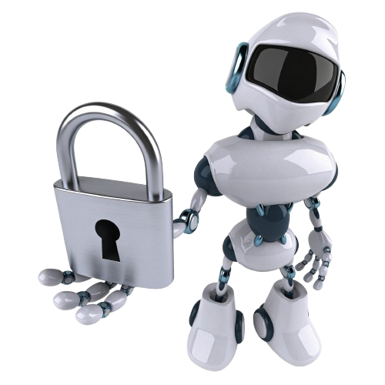
01
SECTION 01
What Is
Secure AI?

Slide 6
WHAT IS SECUREAI?
One Platform. Multiple AI Models.
One Platform,
Multiple AI Models,
Built-In Security
Why This Matters
Secure AI gives you a single, secure workspace to access ALL major AI models:
Shadow AI is already happening in your organization.
Secure AI prevents data spillage, controls runaway costs, and keeps your team productive, all while giving IT visibility and governance.
ChatGPT
Claude
Gemini
Grok
Perplexity
& more
Consumption-based pricing, not per-user.

Slide 7

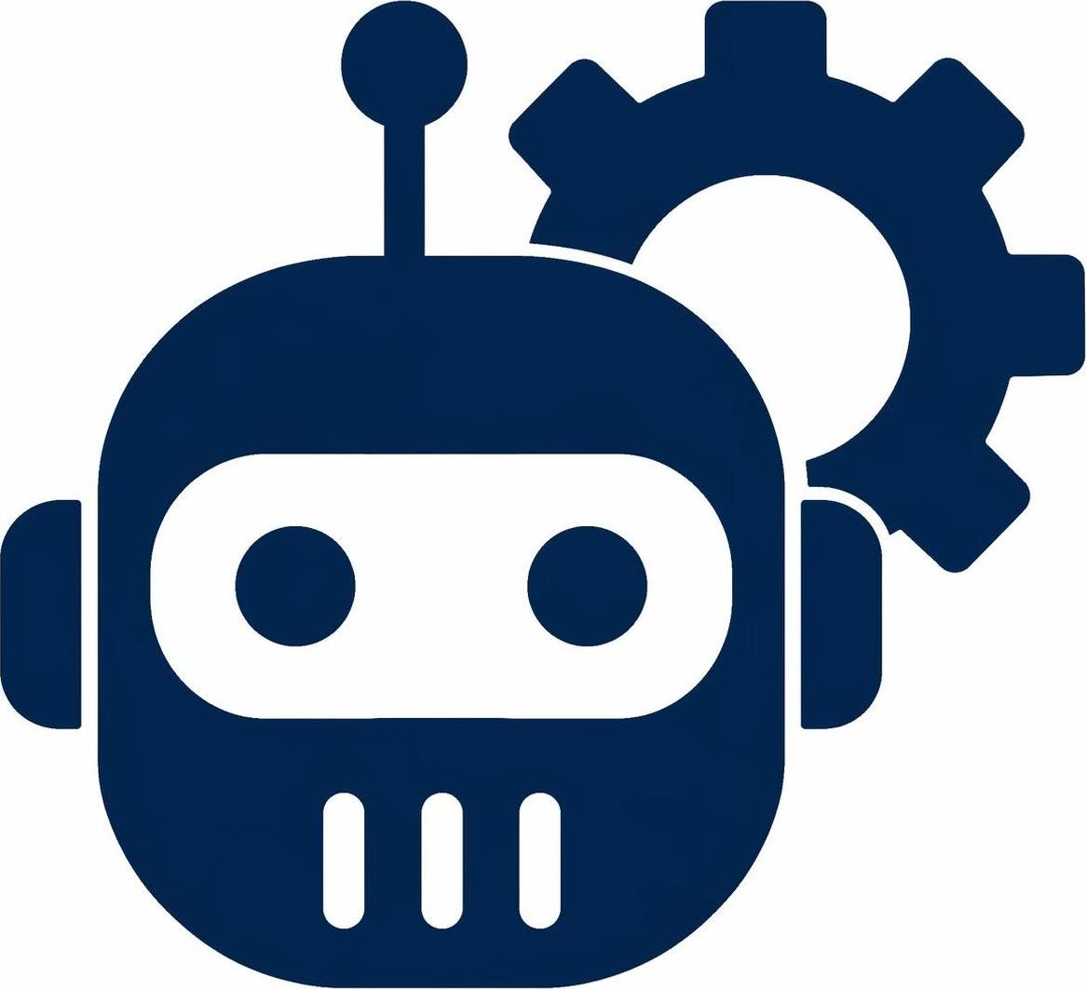


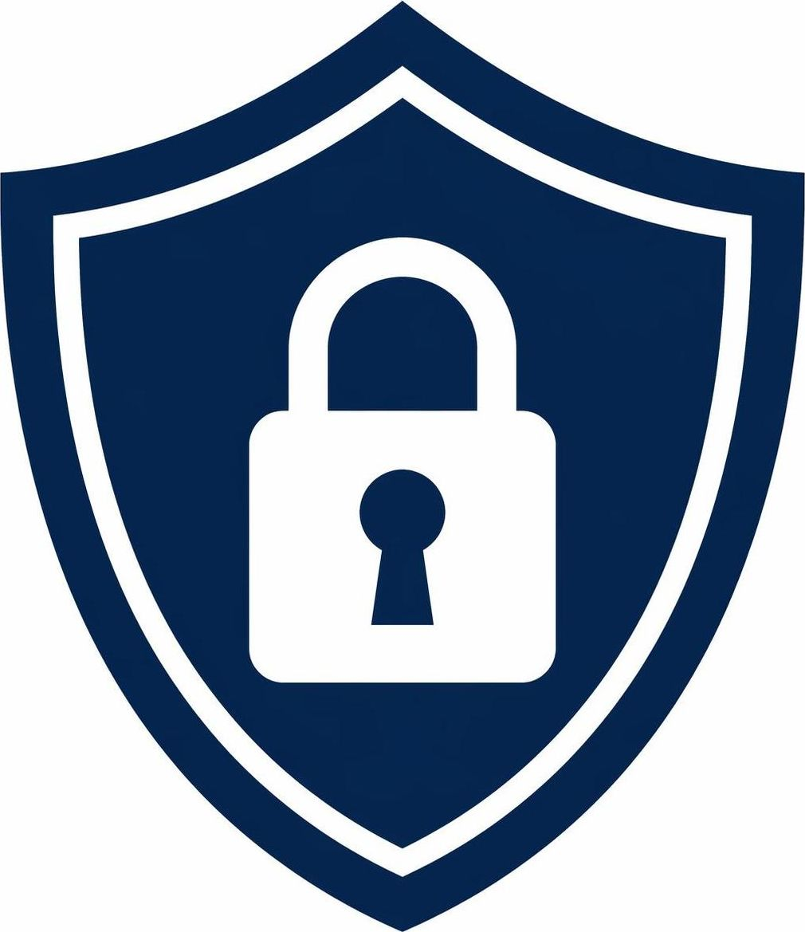



SECUREAI — KEY FEATURES
Eight Ways to Deploy AI Confidently
Multi-Model Chat
AI Agents & Workflows
Community Templates
Web Search Integration
Access ChatGPT, Claude, Gemini, Grok & more from one interface. Pick the right model for the task.
Build custom AI agents & automate repetitive workflows — no coding required.
Save, share, and standardize workflows & agents across your org for consistent AI outputs.
AI answers backed by real-time web data, accurate, current, and sourced.
Data Security Controls
Usage Analytics
Training Portal
Integrations
No model training on your data. Enterprise privacy.
Admins see who's using AI, how often, and which tools, full visibility.
Training videos that cover all major features and highlight various use-cases.
Connects to the tools your team already uses, Microsoft 365, Google Workspace, and more.

Slide 8
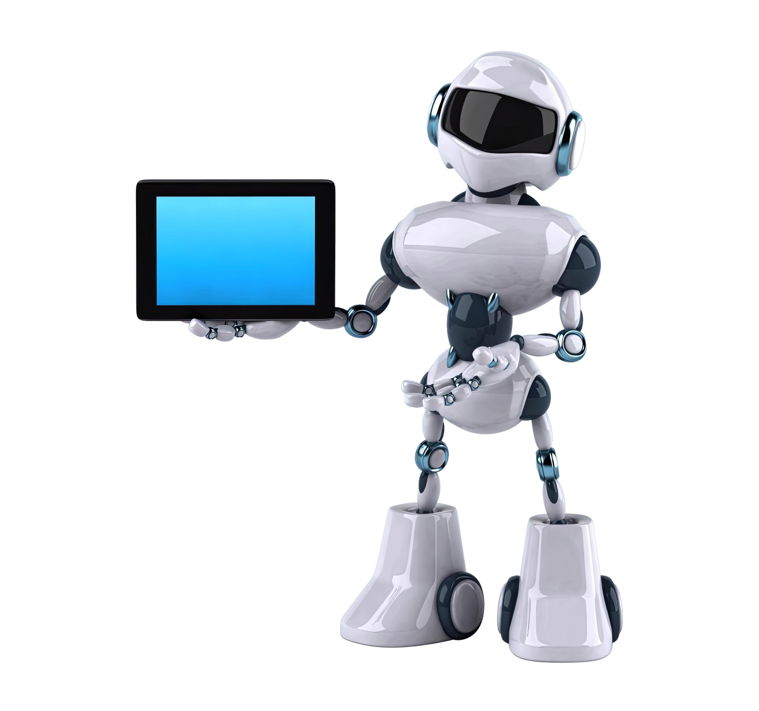
02
SECTION 02
Secure AI
In Action
Platform Walkthrough

Slide 9
PLATFORM WALKTHROUGH
SecureAI in Action
01
Platform Navigation & Multi-Model Chat
Tour the interface, switch between models (e.g. ChatGPT, Claude etc.) and compare responses.
02
Tools & Integrations
Browse a variety of tools and integrations built into the platform e.g. MS365, Google, etc.
03
Workshop
Browse pre-built templates, build a simple AI workflow or an agent, no code required.

Slide 10
WHAT TO EXPECT
Your Onboarding Journey
A guided path to get your team productive, governed, and confident on AI
1
2
3
4
5
Scheduling
Kick-Off Call
Training Session 1
Training Session 2
30-Day Check-In
Email
30 min
45 min + 15 min
1 hour
30 min
Meeting scheduling via email
Review intake form, users & platform configuration
General user training + admin training
Identify & prioritize AI use-cases & where to start
Review progress & next steps
From kick-off to generating value in about 30 days, included in your one-time onboarding.

Slide 11
YOUR NEXT STEP
Get Started Today
Month-to-month pricing with a one-time $2,000 onboarding to get your team productive and generating value fast.
WHAT YOU’LL GET
LEARN MORE & SIGN UP
All major AI models in one secure platform
Sign Up Today
Guided onboarding & team training
Generating value in about 30 days
mytech.com/secure-ai/
Month-to-month: no long-term contract
or contact your Mytech representative
The best time to start is now. The second-best time is today.

Slide 12
Questions?
AI is not the future. It's the present.
Let’s make sure your organization doesn’t get left behind.
THANK YOU · MYTECH PARTNERS
Visit us at mytech.com/secure-ai

