Slide 1


CAPITOL PAIN INSTITUTE
MAKE I.T. EASY KICK-OFF
Notes:
**INTERNAL USE ONLY** Document Published March 15 2021
Please note – all RED text means it needs to be edited
Make sure to change to CLIENT NAME – and change the color to black (in red so it doesn’t get missed)

Slide 2

Today’s Agenda
Providing the Best IT Experience is about knowing you, your staff, your technology, and your business operations and goals.
About Mytech Partners
How We Can Help
When to Contact Mytech
How to Submit a Request & H.E.L.P. Center Demonstration
Client Satisfaction Feedback
Questions
Notes:
**INTERNAL USE ONLY**
If you are rearranging or adding to the presentation - ensure the agenda correctly reflects it.

Slide 3
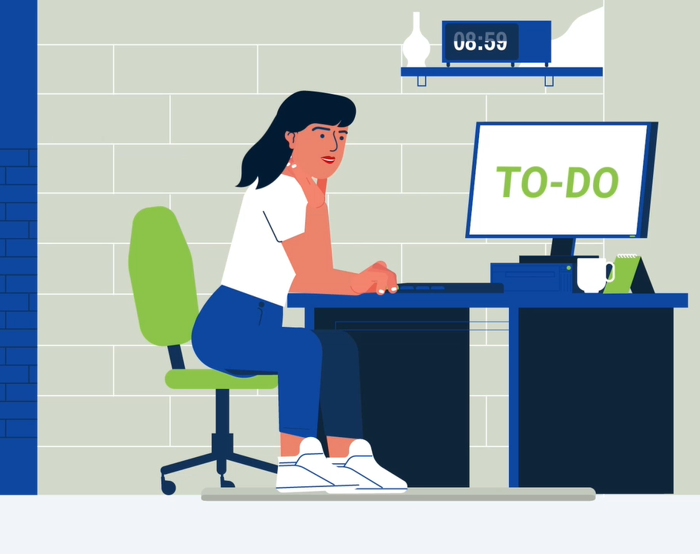
About Mytech
Why did you choose us?
Business & Technology Consulting & Support for local, small to medium sized businesses, like you!
Security First – Fully protect you and your team without sacrificing productivity!
Achieve 4X More Value and Productivity – When we remove your IT challenges, you can spend more time serving your clients and solving other business problems.
We aim to Make I.T. Easy – This doesn’t necessarily mean it will be easy for us… that’s why you hired us!
Notes:
**INTERNAL USE ONLY**
This information should be focused on what the workforce of the client cares about. They tend to not care about how many years Mytech has existed, how many employees we have, etc. They care about how we can help make their lives/jobs better or easier. When appropriate, use the terminology of the Mytech Strategy. Incorporate our Brand Promise, One Phrase Strategy, our Mission, Vision, and Values.
When appropriate, ask the primary contact or leadership team of the client if they would like to be a part of this explanation. Why did they choose us, Mytech. How do they foresee us helping their business?
We are BUSINESS & TECHNOLOGY CONSULTANTS – Why does this matter? We are more than just tech support. We have experience working with numerous local, similar sized businesses. Believe it or not, 80% of the challenges those businesses are facing are all the same. We go beyond fixing what is “broke”, and provide resources and consultation proactively. We work to fully understand the business’ goals and growth strategy, so we can ensure their technology is not a prohibitory, but an enabler. It’s all about Setting them up for Success.
SECURITY FIRST – Many times when people think of security, they think will just make their job harder. It’s important to state that while we do put security first, we work to find methods that do not negatively impact the users productivity. We try to make IT easy & secure.
4X MORE VALUE & PRODUCTIVITY – Our goal is to reduce the amount of time they need our support. We work to proactively remove IT challenges, so they can spend more time doing their job and serving their clients
MAKE I.T. EASY – This is the ultimate goal, and honestly if they only take away this from the meeting – that’s a win. How can we make technology easy for them. If there is a way we can help make IT Easy even before there is a problem, encourage them to challenge us with those requests. Is there past client example you can provide? Something simple that isn’t “something was broke, we fixed it” → but more of “this client said it would help them do their job if only__________________, and we made that happen”

Slide 4
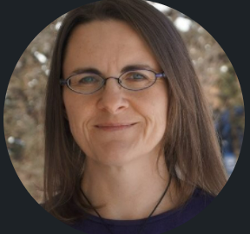
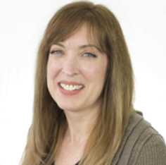
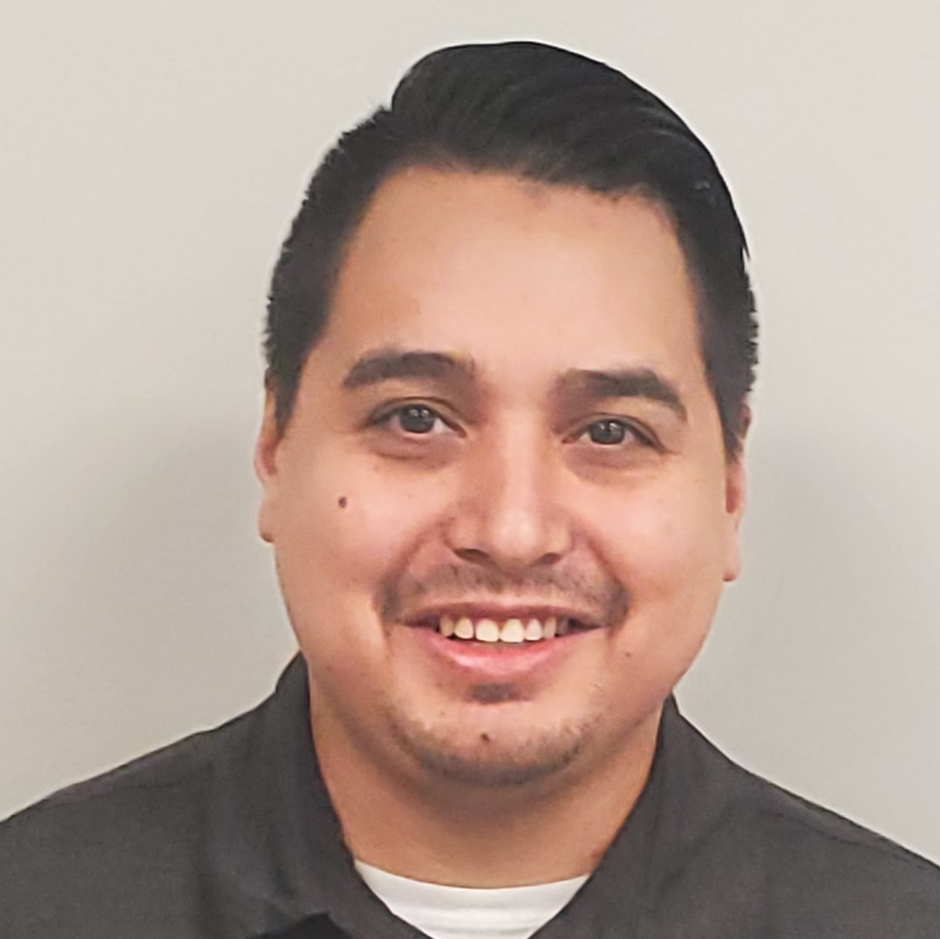
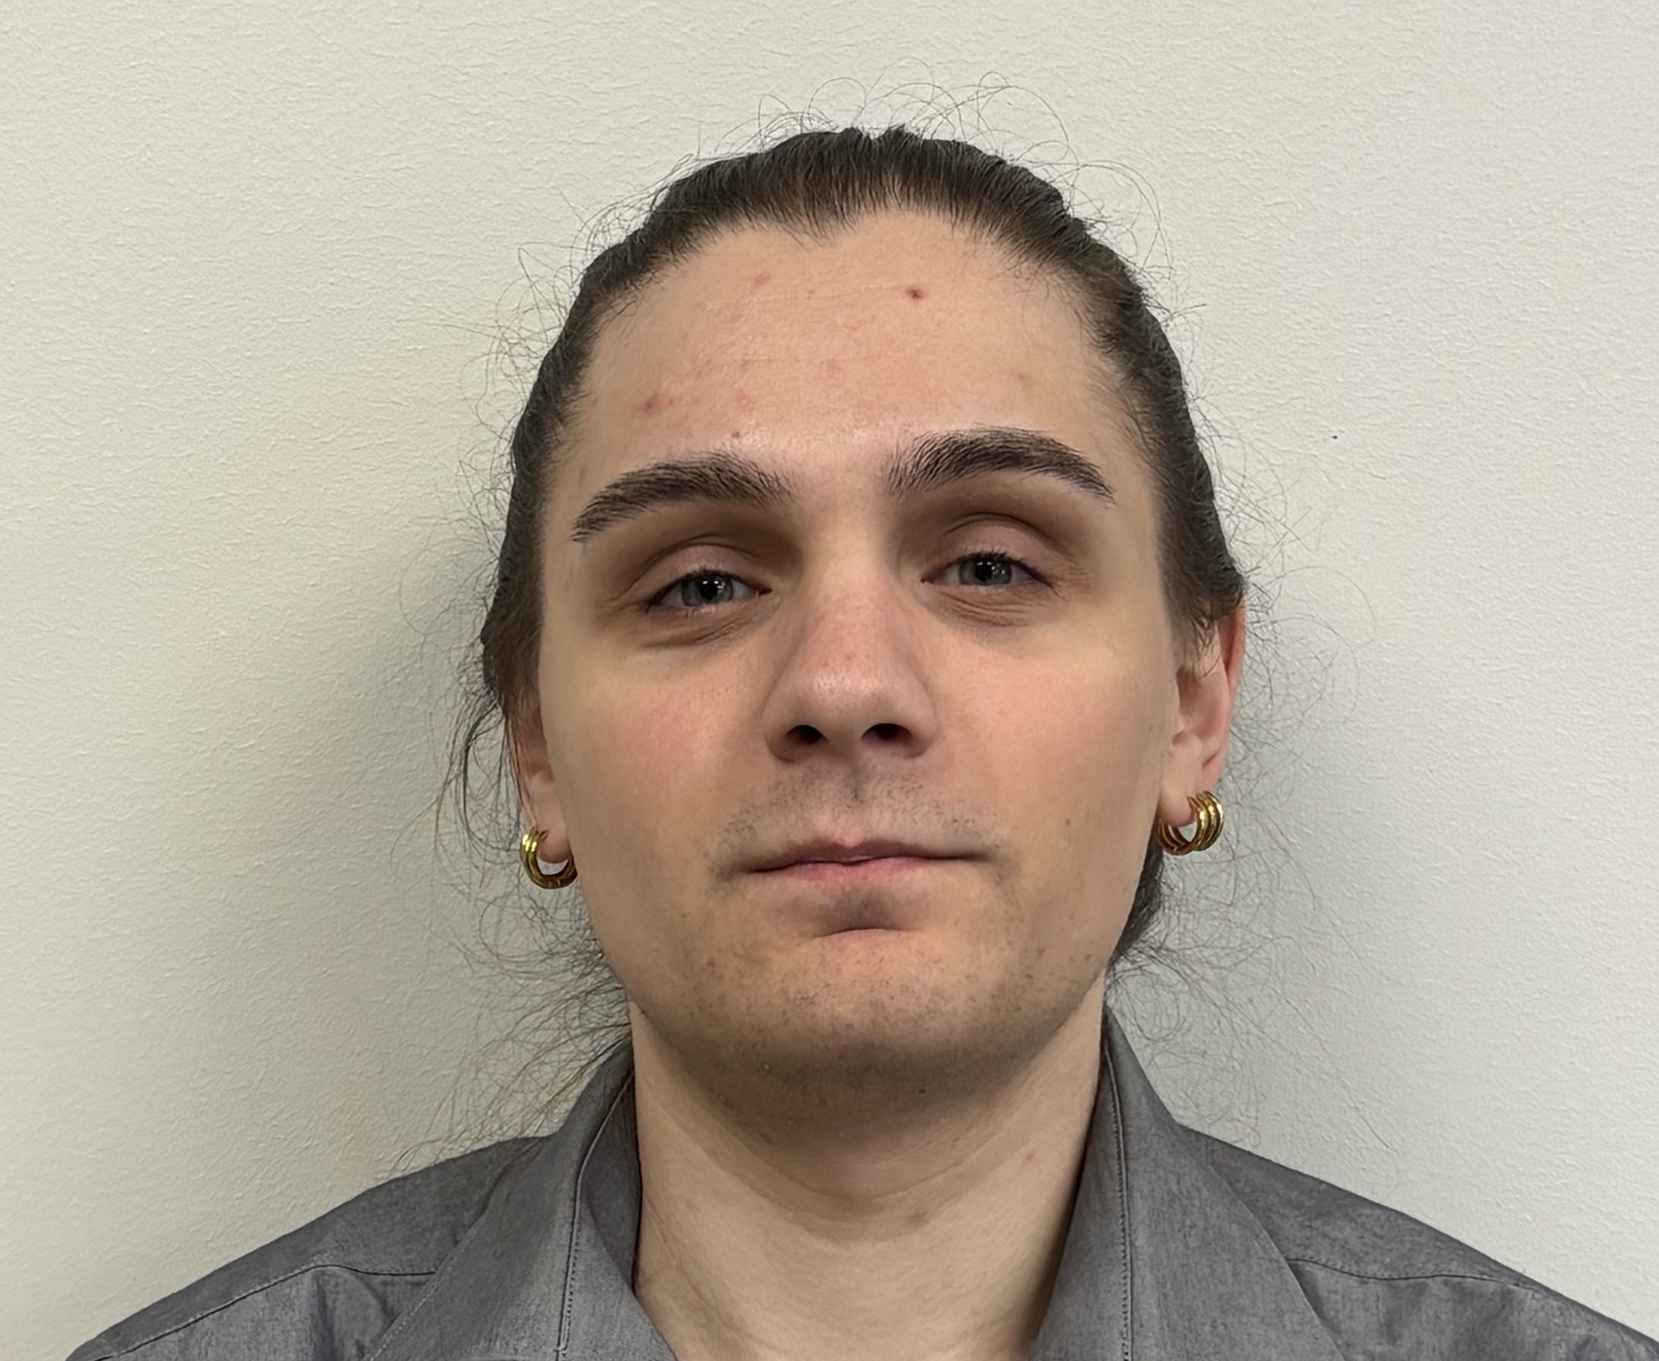
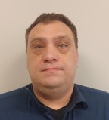
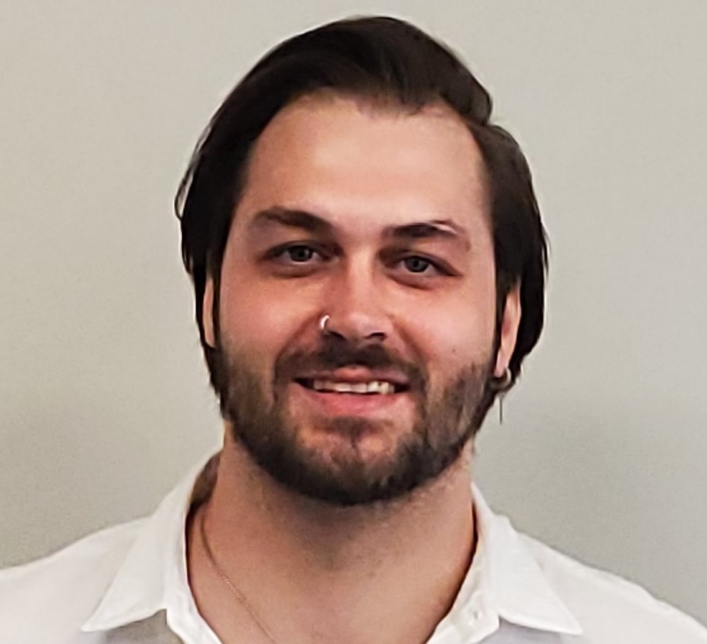
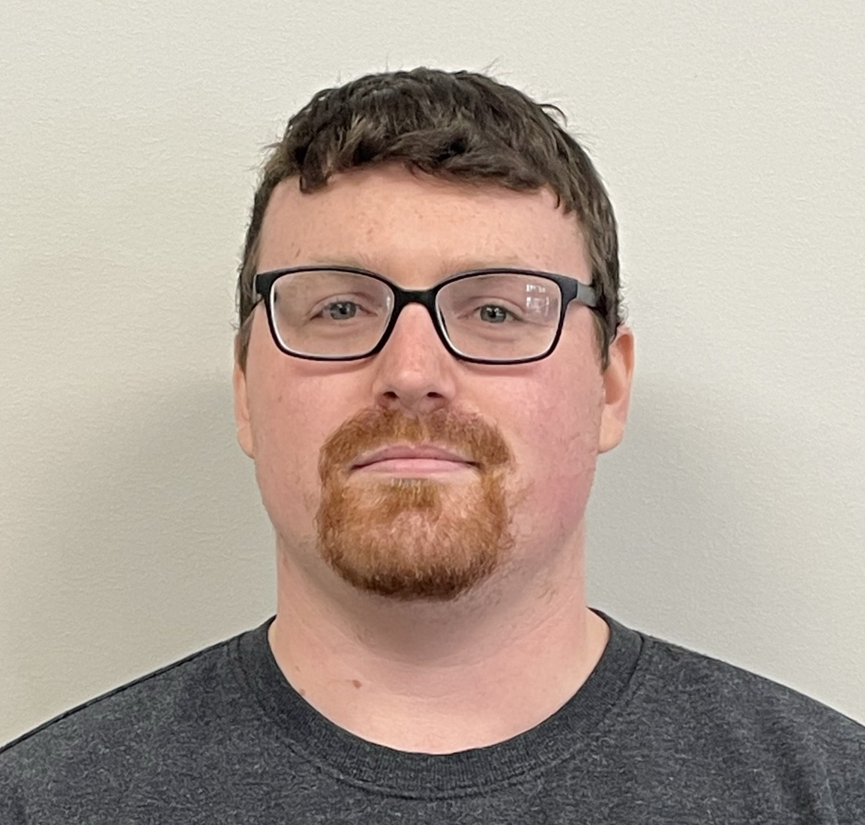
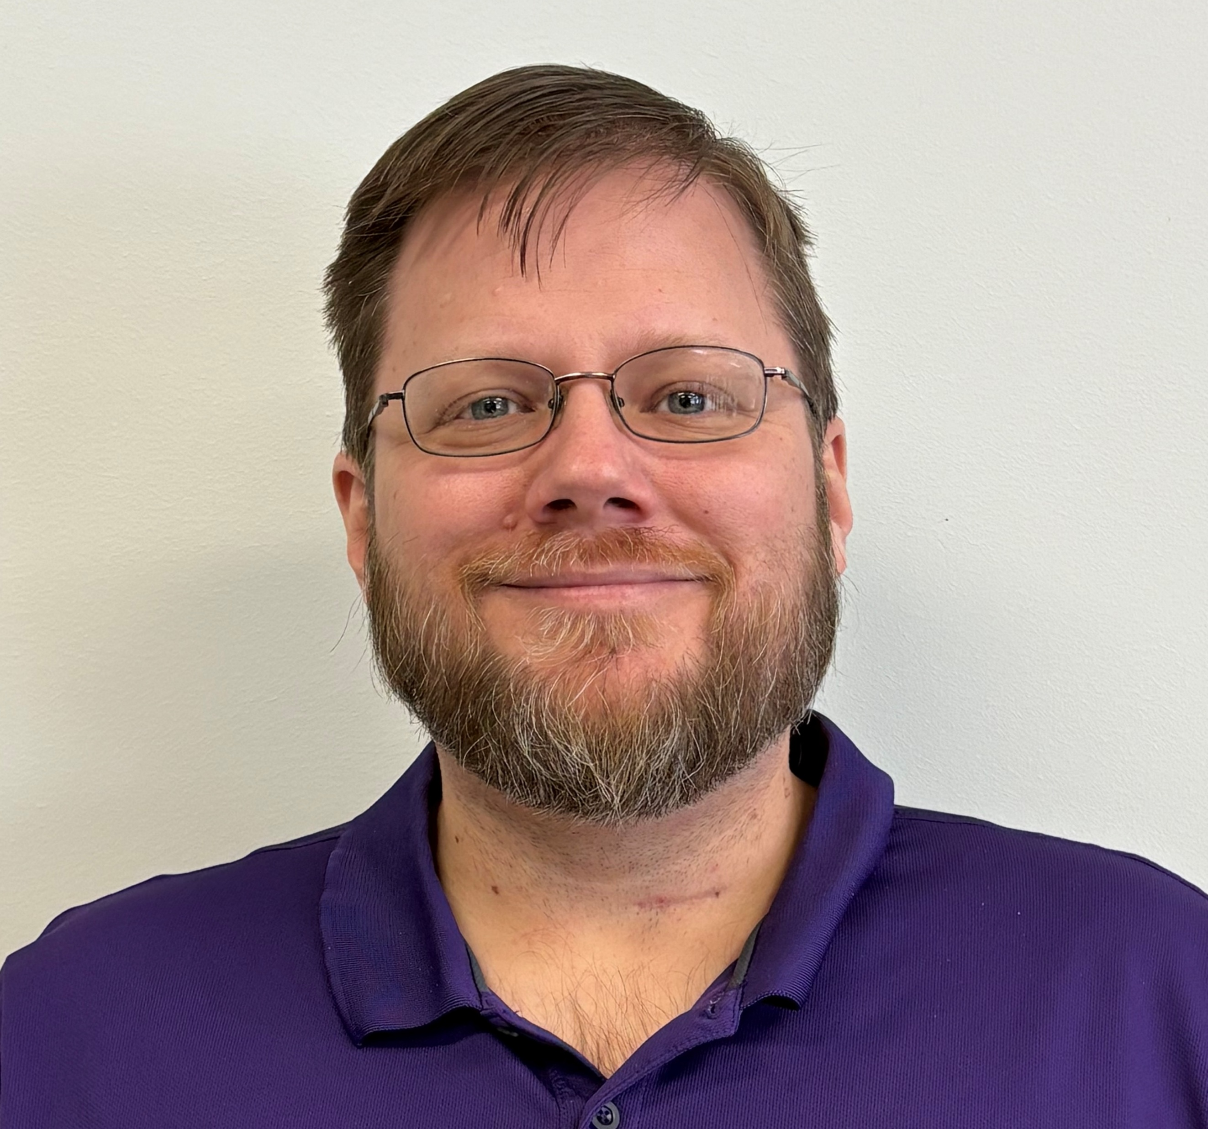
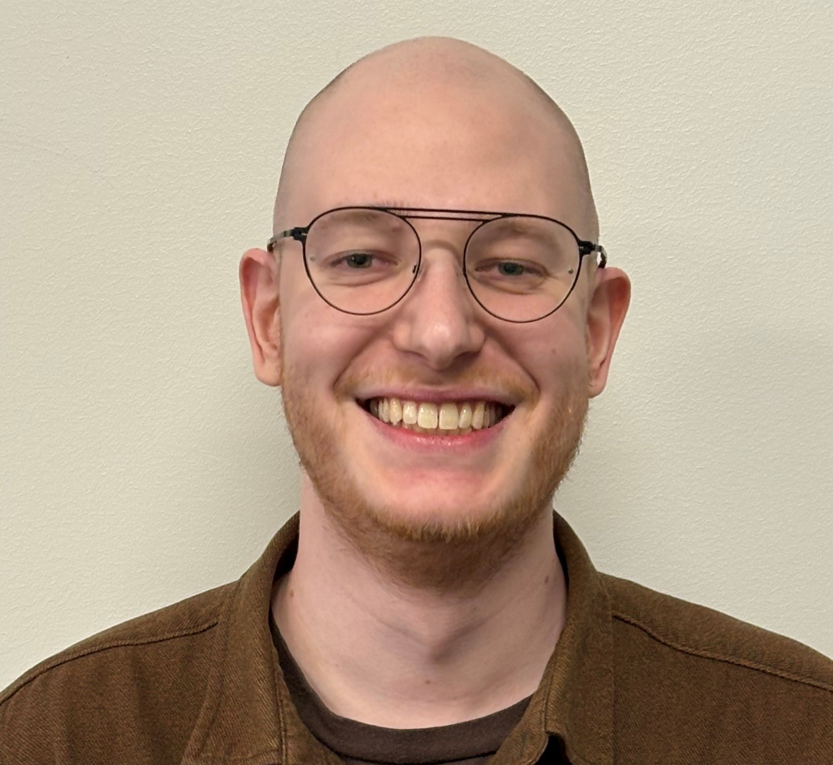
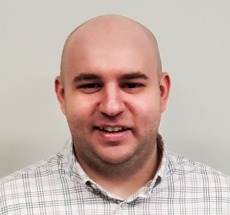
TEAM
Meet Your Team
10
Julia Froemke
Service Manager
Dedicated Mytech Team
Terry H.
Service
Coordinator
Joe P.
Service Tech III
Michael W.
Service Tech II
Chad L.
Service Tech II
Aron W.
Service Tech II
Dawson T.
Service Tech I
Tom A.
Field Tech II
Jordan G.
Field Tech I
Brandon U.
Field Tech I
Notes:
**INTERNAL USE ONLY**
Left click on the image icon and select CHANGE PICTURE
Navigate to the picture directory at G:\MTPMarketing\MarketingCommon\jody\id and visitor badges\mytech id badges\edited for profile pics
Insert each team members picture and adjust their name and title. Don’t forget their Account Manager, Service Coordinator, etc.
Delete the unused picture and icons

Slide 5







We are ready to help!
IT SUPPORT
REMOTE & ONSITE
EMERGENCY AFTER HOURS IT SUPPORT
When your technology doesn’t work, you don’t either!
COMPUTER / PC DEPLOYMENT
24/7 MONITORING & ALERTS
MICROSOFT PATCH & SECURITY MANAGEMENT
DISASTER RECOVERY & BACKUP MANAGMENT
Notes:
**INTERNAL USE ONLY**
The intent of this slide is to give the staff a high level overview of the services we provide. This is for a couple reasons.
Maybe in the past the client has had several vendors for each component → we are showing them we are providing them a holistic program
Maybe they have an internal accidental technologist → we are setting the expectation of who they should come to.
Make sure you don’t go down a rabbit hole of information that the user base won’t retain. Keep this brief.

Slide 6





Need Help?
How to Submit a Service Request:
HELP Center
Request support (submit tickets) and review the status of open requests.
EMAIL
Send an email to help@mytech.com, and your request will automatically route to your service team.
CALL
Call 651-366-6524 and select TEAM 10 to submit a service request. This is the best option for emergencies.
Notes:
**INTERNAL USE ONLY**
BE SURE TO INPUT THE CORRECT TEAM NUMBER– and change color to BLACK
NOTE – This is to show them the various ways to request support. Know your audience. There are some industries/organizations that are going to feel more comfortable calling vs. using a desktop application because maybe they are on the road, or not always at a computer. Although the HELP Center and EMAIL are the best way for us to handle help requests, remember we are here to MAKE IT EASY for the client, and if that means they want to call …. Support that! ☺
If applicable – Hand out Team Support Cards & Mouse Pads

Slide 7


Need Help?
Support Hours & Emergency Requests
Help Desk Support Hours:
7:00 a.m. – 7:00 p.m. (Central)
Monday – Friday
Non-Emergency Service Targets: Triage within 15 minutes
In-Progress within 6 hours
AFTER-HOURS EMERGENCY WORK
IS BILLABLE
Notes:
**INTERNAL USE ONLY**
SLT (Service Level Target) DO NOT USE THE ACRONYM SLT without explaining it. The users will NOT know that term. - Encourage users to consult with their service coordinators if they feel a ticket needs to be addressed sooner. Not everything can be an emergency – By helping us understand the urgency/priority of the request we can better allocate the right resources to the right problem in a timely fashion.
*Set the Next Person up for Success (Users and Mytech) by providing examples of help requests that would fall under the standard SLT, and which are considered emergencies. Help them understand.
MAKE SURE YOU ENTER - After-Hours Emergency Requests & Billable Work Must be approved by: (and change color to BLACK) - Give brief explanation of the track of a ticket when it is an after-hours emergency request.

Slide 8
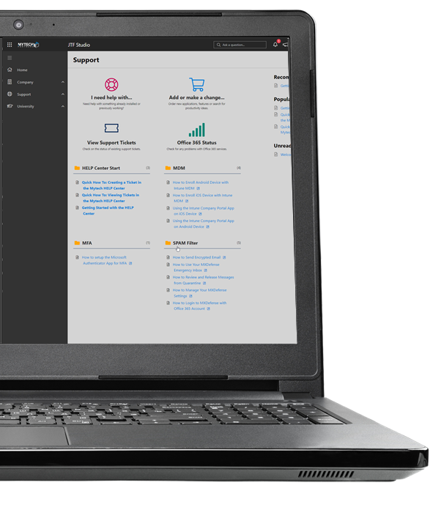


Mytech HELP Center
Let’s explore!
Request for Service
    Where to find the Help Center
    Logging in
    How to submit a service ticket
    How to check the status of open tickets
Notes:
**INTERNAL USE ONLY**
If you will have access to Mytech H.E.L.P center, DELETE SLIDES 12 – 21 that show how to submit a ticket, as well as go through the learning/ bigger brains. This will be covered through a live demo when possible.
* Please note. When doing a live demo, it is important to have profile that is similar to what the users will see. It will be confusing if you your Mytech H.E.L.P profile has a lot of additional buttons, questions, etc. that differ from the experience they will have when they go into the portal.

Slide 9
You can submit a Service Ticket using the Mytech HELP Center
Windows users may find the Mytech HELP Center icon in:
Start Menu
The System Tray
Teams Application
MacBook users will have an icon on their desktop

Slide 10
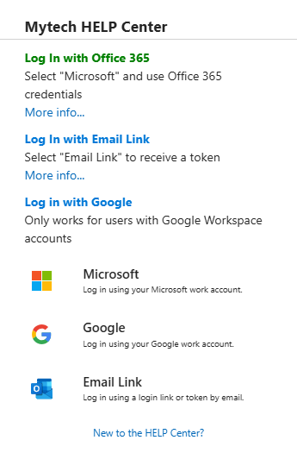
Mytech HELP Center
Logging in for the first time
TODAY - When you see the Log In options select Email Link
Notes:
**INTERNAL USE ONLY**
If you will have access to Mytech H.E.L.P center, DELETE SLIDES 12 – 21 that show how to submit a ticket, as well as go through the learning/ bigger brains. This will be covered through a live demo when possible.
* Please note. When doing a live demo, it is important to have profile that is similar to what the users will see. It will be confusing if you your Mytech H.E.L.P profile has a lot of additional buttons, questions, etc. that differ from the experience they will have when they go into the portal.

Slide 11
Mytech HELP Center
Logging in for the first time
Coming Soon (CPI Tenant Migration)…
When prompted for a new Microsoft password you will see this window again.
Select “Microsoft” to continue with
Single Sign On
Notes:
**INTERNAL USE ONLY**
If you will have access to Mytech H.E.L.P center, DELETE SLIDES 12 – 21 that show how to submit a ticket, as well as go through the learning/ bigger brains. This will be covered through a live demo when possible.
* Please note. When doing a live demo, it is important to have profile that is similar to what the users will see. It will be confusing if you your Mytech H.E.L.P profile has a lot of additional buttons, questions, etc. that differ from the experience they will have when they go into the portal.

Slide 12
How to Create a Service Ticket

Slide 13
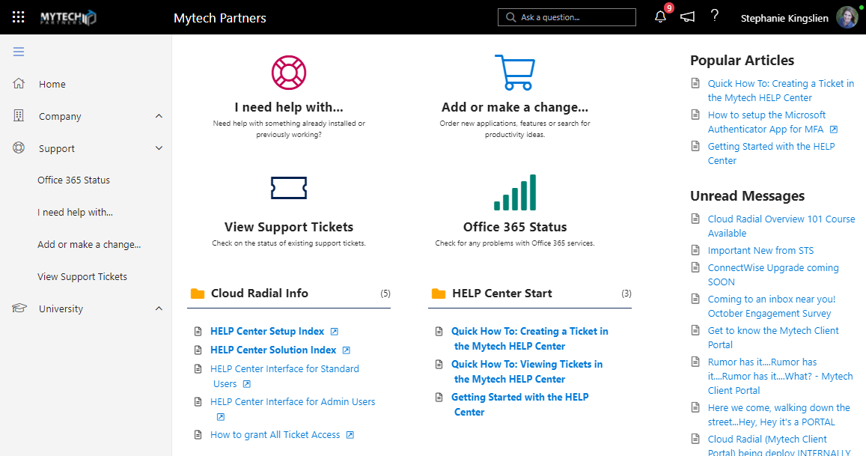

STEP
1
Click I need help with…
Notes:
Step 3: Select an Issue
Pick the Issue that corresponds the problem you're encountering
NOTE: If you don't see the problem listed, select "Not Listed Here"

Slide 14
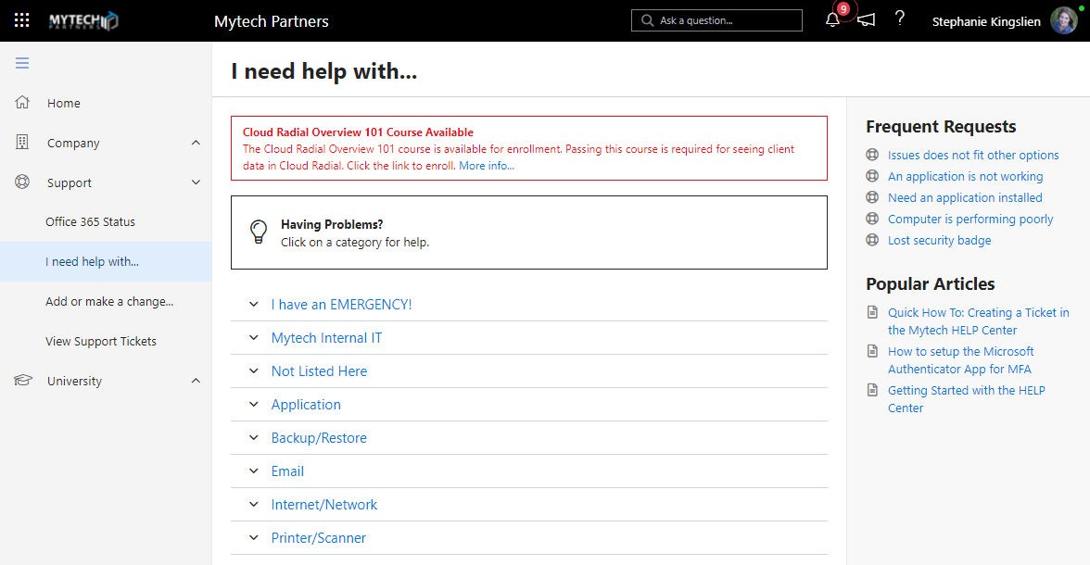
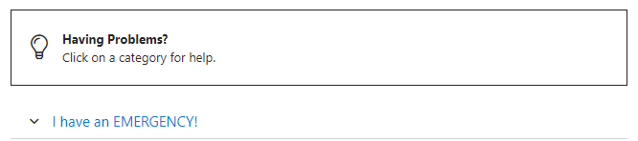

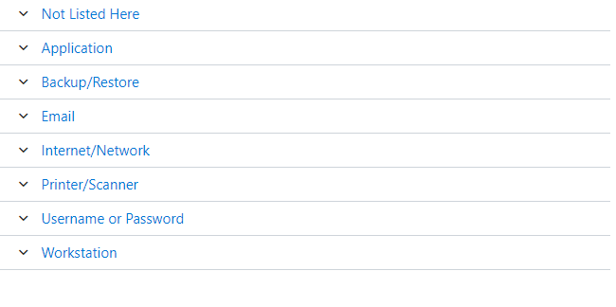
STEP
2
Choose the category that
best matches your request.

Slide 15
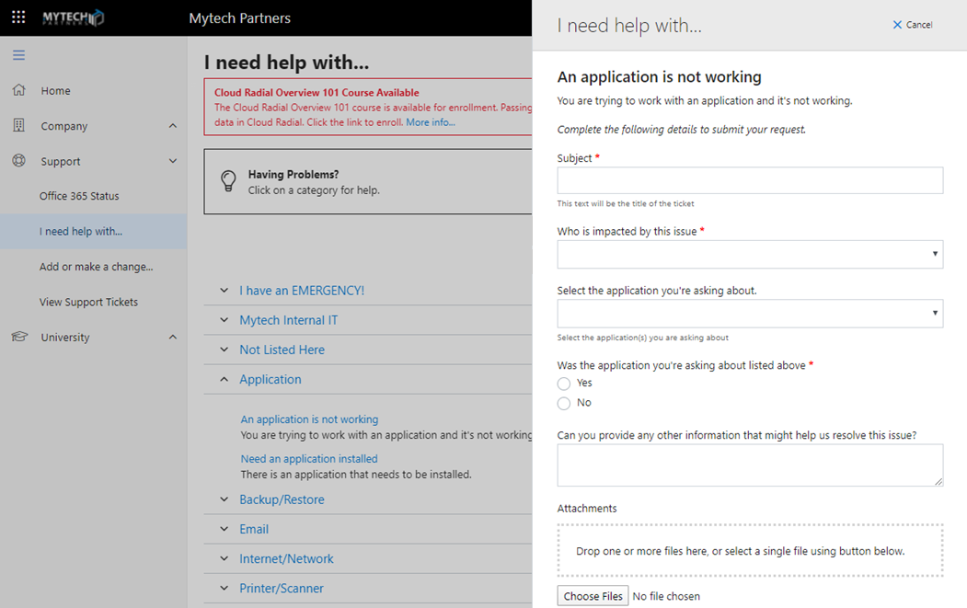

THIS SETS THE PRIORITY
STEP
3
Enter the ticket
information
Notes:
Step 3: Ticket Information
Enter a subject for the ticket, this will become the title of your ticket
Select how the problem has impacted your company
Are you the only one experiencing the problem, or is it more wide spread
Are you, or others, able to find a work around, or has the problem completely stopped your work

Slide 16
How to Check the Status of a Service Ticket

Slide 17
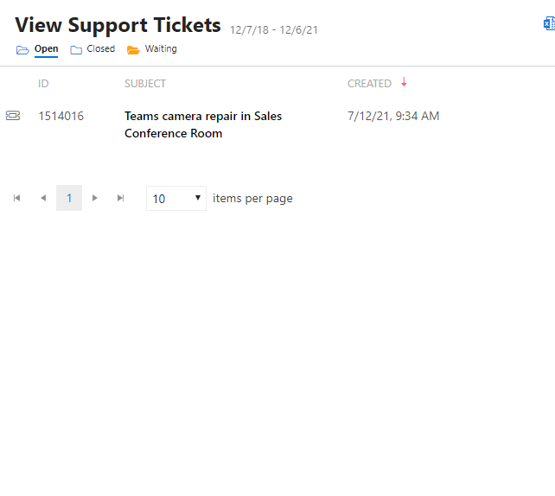

VIEW
Filter by Open, Closed, or Waiting to view status and/or leave a message.
Notes:
Select "View Support Tickets"
To view your tickets, click on "View Support Tickets" from the portal Home page or the Support section
Select or Search for a Ticket
You can filter tickets by selecting the "Open", "Closed" or "Waiting" options
Open a ticket by locating it and double clicking on the ticket number
Or used the "Search" option to search for a specific ticket (see Step 4 for information on the Search feature)
Review Ticket Details
You can use the "Ticket Options" to close a ticket if the issue is resolved
You can view "Discussion", "Timeline", "Details" or "Feedback" for the ticket
If you want to update the ticket, add your notes to the available text box and click "Send"
There is also an option to attach a file

Slide 18
Helpful Documents

Slide 19
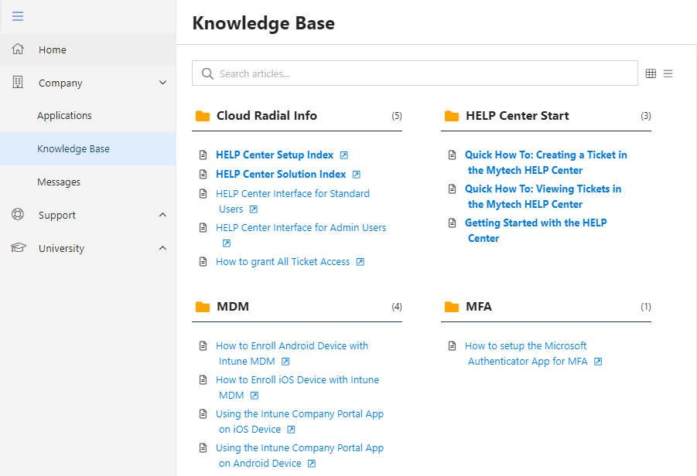
Mytech Products, Solutions &
How-To Topics
Find information and
How-To topics for the most commonly asked questions and support requests.
Have a request? Send any suggestions to help@mytech.com.
Notes:
**INTERNAL USE ONLY**
Encourage users to constantly check back to this resource, as we will be continually adding helpful content. Additionally if there is something that they would like to see there, encourage them to submit a ticket.

Slide 20
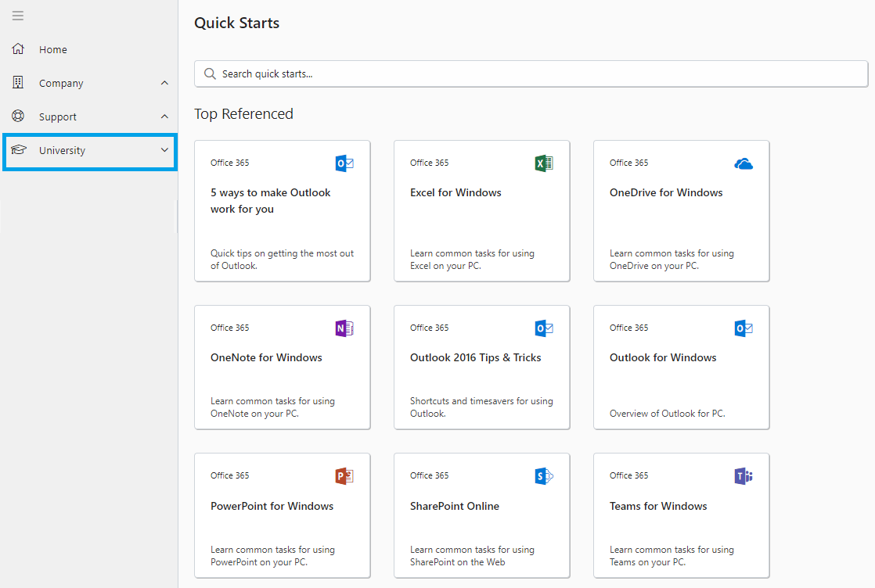
University
Training
Training on common questions for Office 365 applications.
Notes:
**INTERNAL USE ONLY**
Encourage users to constantly check back to this resource, as we will be continually adding helpful content. Additionally if there is something that they would like to see there, encourage them to submit a ticket.

Slide 21
Computer Updates and Patching

Slide 22
A few reminders
For best performance, computers need regular patching.
Leaving your computer on once a week to update
will help keep it up to date. For best results:
Computer on
Connected to power
Connected to internet
Laptop lid open
PATCH & SECURITY
MANAGEMENT
Notes:
**INTERNAL USE ONLY**
The intent of this slide is to give the staff a high level overview of the services we provide. This is for a couple reasons.
Maybe in the past the client has had several vendors for each component → we are showing them we are providing them a holistic program
Maybe they have an internal accidental technologist → we are setting the expectation of who they should come to.
Make sure you don’t go down a rabbit hole of information that the user base won’t retain. Keep this brief.

Slide 23



Client Satisfaction
Feedback is important!
After each ticket is closed, you will receive a survey asking for feedback on how we did! Please take a moment to tell us!
Why?
We want to know the good/bad/ugly
We are here to listen and improve
We adapt to the feedback we receive
Notes:
**INTERNAL USE ONLY**
Set a clear expectation upfront.
Set the level of service they should be receiving from us. At Mytech we strive to Practice Both Confidence and Humility, and we understand that there is always room for improvement. We strive to Never Stop Learning and together we work to Reject Mediocrity. (incorporate our values whenever possible)
Clearly define the meaning between the Green, Yellow, and Red faces. What will happen after they submit feedback, especially if they submit a Yellow or Red.

Slide 24


Submit Requests
When in doubt…ask!
Provide Feedback
We need your help!
Help us Make I.T. Easy for you!
Notes:
We Need Your Help:
Provide Feedback - Encourage everyone – users, executives, primary contacts, etc to Communicate Directly and Openly with us.
Submit Requests – If something isn’t working, don’t assume someone else has submitted a request. If something doesn’t look quite right (suspicious email, unannounced changes, etc) submit a request.
* This may be an opportunity to inform users that if they have any open requests from a previous provider, we do not have those, please submit a ticket to us.
When in doubt ask! - We aim to Provide More Value than we Receive in Payment so if there is a way we can help the client, we will.

Slide 25

Questions?
We are ready to help!

